Slide 1
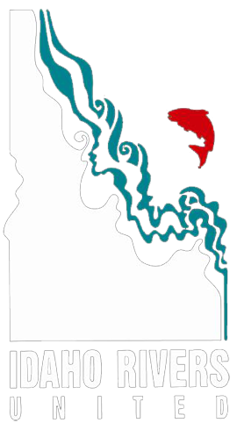
Wild and Scenic Rivers Act
&
Management options
South Fork Boise Collaborative – 2/22/24
Notes:
Intro

Slide 2
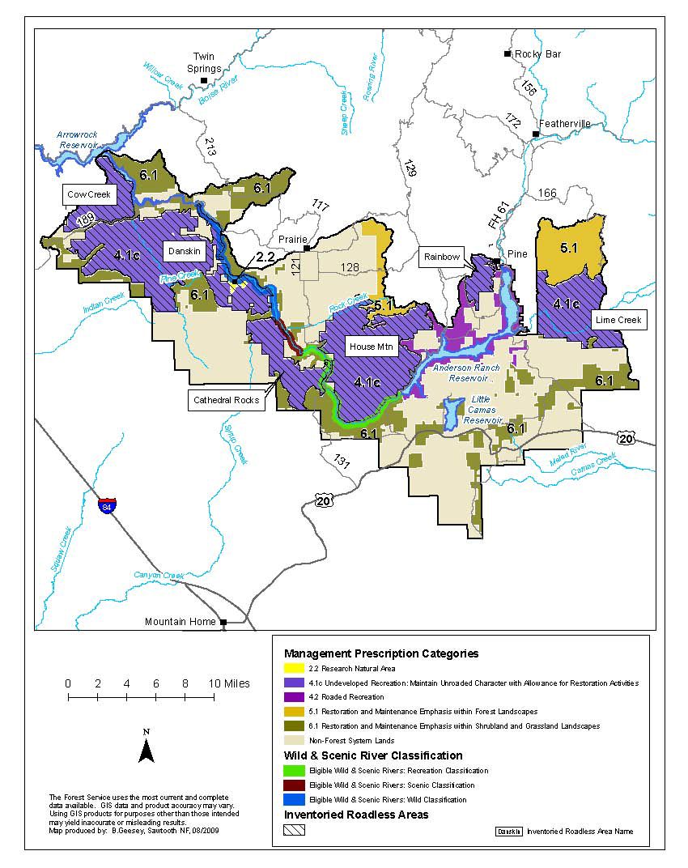
Notes:
The breakdown of Boise National Forest’s Management Area 1 – Lower South Fork Boise River.
Here we can see the overlay of general management prescriptions as well as the three different sections of the SFBR that are eligible for inclusion in the WSRA.

Slide 3
Notes:
Zoomed in just a bit we see the three sections:
Green: Section 1 (13.13 Mi), From Anderson Ranch Dam to Mennecke Creek (Recreational: ORV – Rec, Geologic, Heritage)
Magenta: Section 2 (3.13 Mi), From Mennecke Creek to Trail Creek (Scenic: ORV – Recreation, Geology)
Blue: Section 3 (12.27 Mi), From Trail Creek to Crank Creek (Wild: ORV – Scenic, Recreation, Geology)
Interesting to me is the fact that Fisheries is not identified as an ORV for the full system.
4.1c – undeveloped rec *maintain unroaded character with allowance for restoration activities
6.1 – restoration and maintenance – emph shrubland and grassland landscapes.

Slide 4
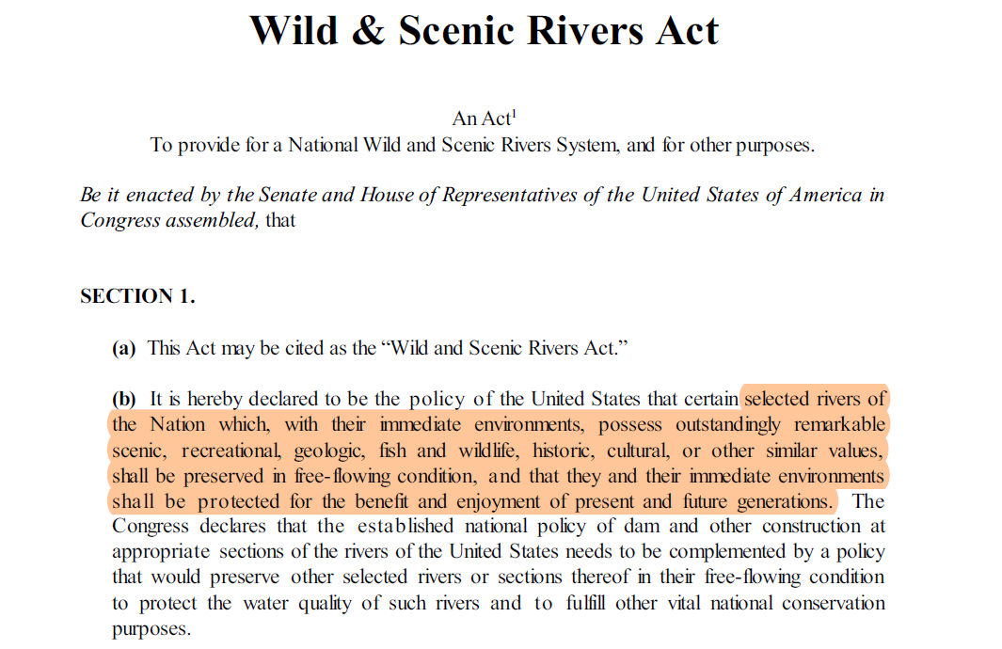
Notes:
So…What does the WSRA actually do?
Established national policy that select rivers that possess outstandingly remarkable values (ORVs), shall be preserved in free-flowing conditions and that their immediate environments shall be protected for the benefit and enjoyment of present ant future generations.

Slide 5
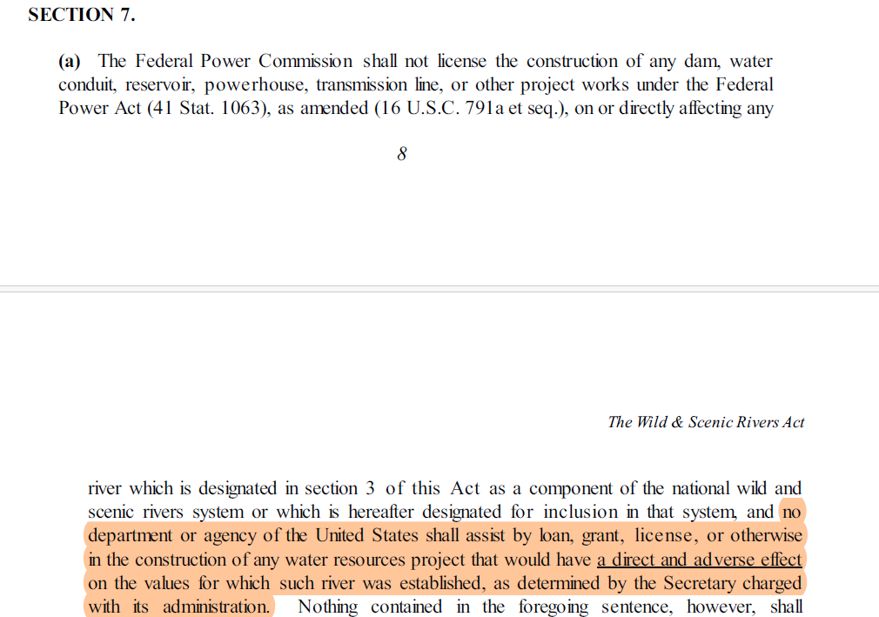
Notes:
For management restrictions, the largest and broad protections come from Section 7 of the Act. Primarily, this permanently protects rivers that are components of the national wild and scenic river system from hydro development and water resource projects that would have a direct and adverse effect on the values aka ORVs of the river in question.

Slide 6
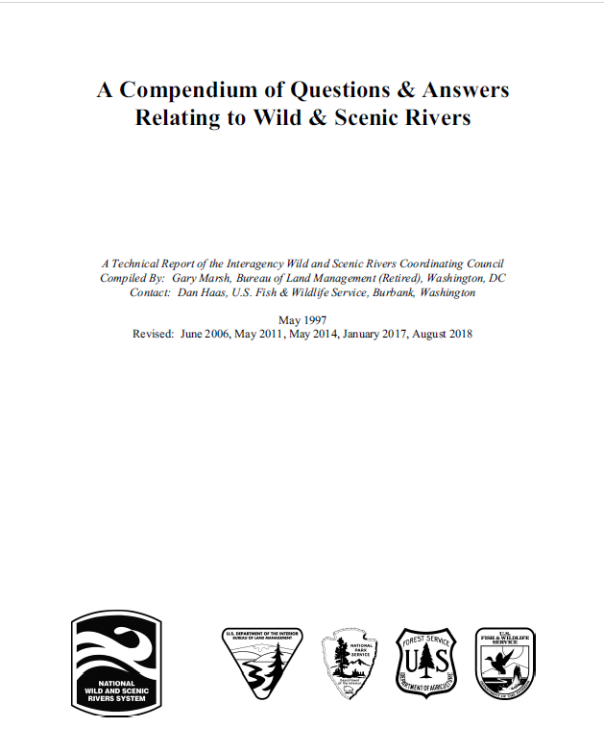
What is a water resource project?
“Examples include, but are not limited to, bank stabilization/revetments; bridges (e.g., abutments, piers, approaches); emergency repairs; channelization; channel restoration; culverts; dams and dam removal; dredging or excavation; fish habitat/passage restoration or enhancement; gravel mining; in-channel transmission towers; levees; pipelines; recreation facilities such as boat ramps and fishing piers; water diversions/wells; and activities that are authorized under Section 404 of the Clean Water Act by the United States Army Corps of Engineers” – pg.50 WSR Coordinating Council Compendium
Notes:
What is a water resource project? According to the Wild and Scenic Coordinating Council, which is made up of river managers from NPS, BLM, Forest Service, and FWS, it’s a very broad definition. Typically, section 7 consultation would happen parallel to agency analysis and environmental review, not as a separate NEPA process.

Slide 7
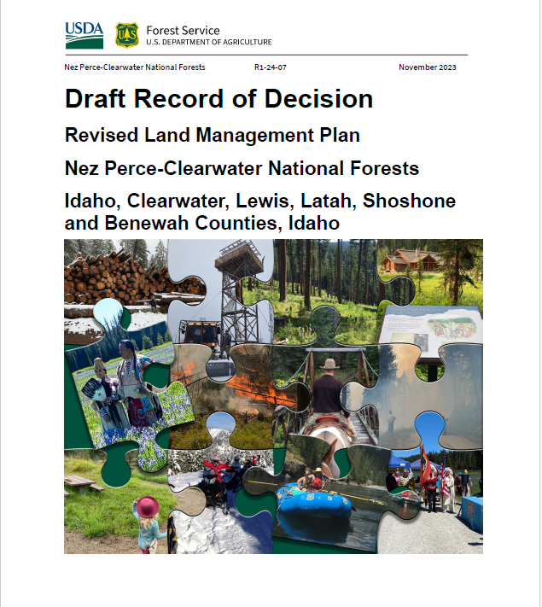
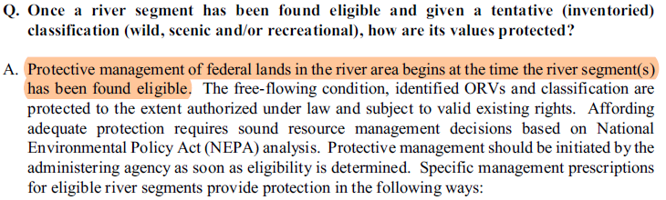
What about rivers not formally designated (eligible/suitable)??
Notes:
This is again taken from the coordinating council Q and A and is widely adopted by management agencies responsible for the management of WSRs within their boundaries.
Essentially, this policy ensures that until a river is formally designated, or not, the conditions and qualities of which it was found eligible in the first place are not degraded in the interim.

Slide 8
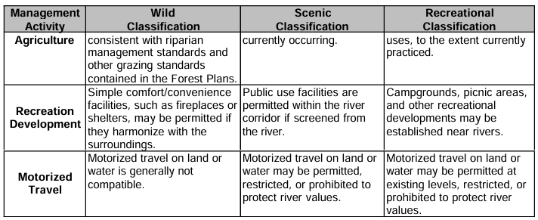
Table WSR-1 Wild and Scenic River Direction from FSH 1909.12
Notes:
A quick note on the classifications- ie recreational, scenic, or wild, the Forest Service Handbook lists a bunch of general outlines for the type of management activities that are permissible based on classification alone, notwithstanding ORV implications.

Slide 9
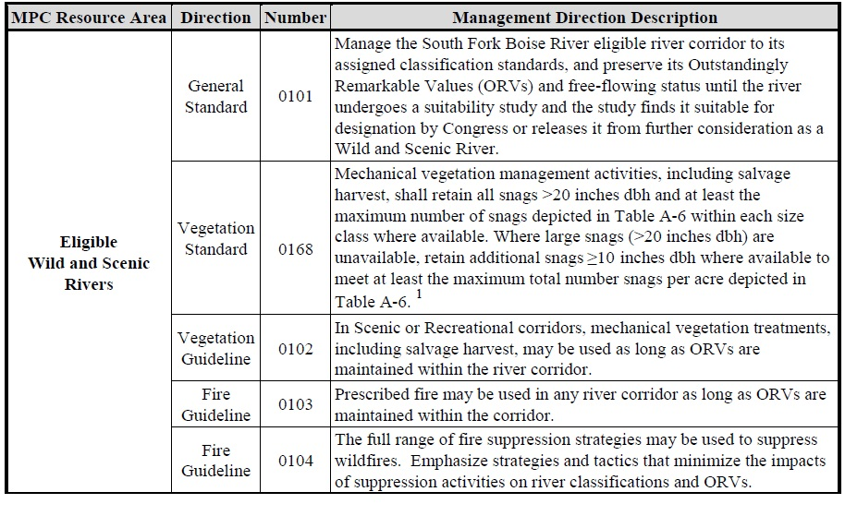
Notes:
Here – taken from the Boise NF management direction for Zone 1, we see it explicitly stated that all projects must be designed in a way that they do not negatively impact the ORVs, free-flowing condition, or water quality for which the section was initially deemed eligible.

Slide 10
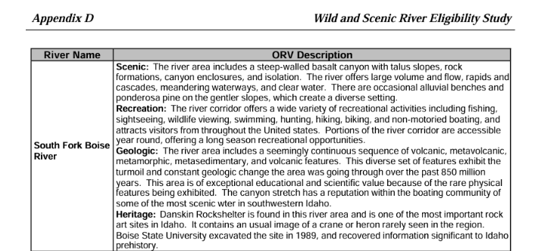
Section 1: Recreational – ORVs: Recreation, Geologic, Heritage
Section 2: Scenic – ORVs: Recreation & Geologic
Section 3: Wild – ORVs: Scenic, Recreation, and Geologic

Slide 11
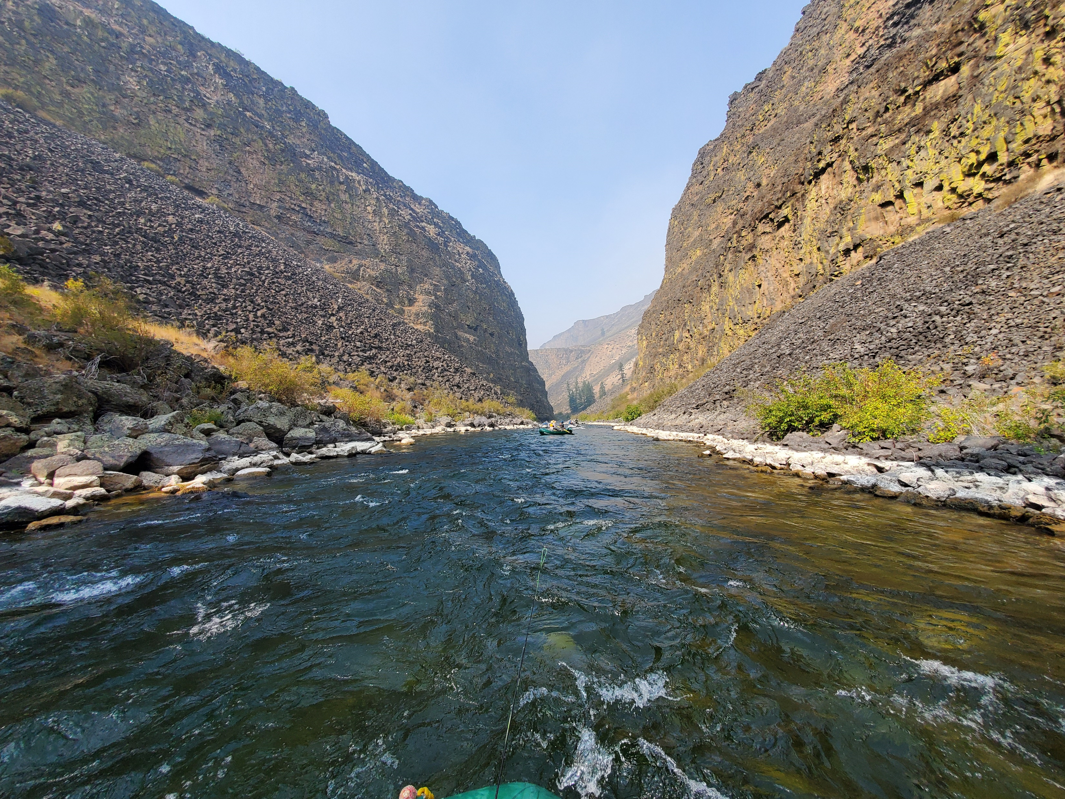
So… What does that all mean for potential work on the SF Boise?
Notes:
The short answer is…NEPA.
Any project that you’re looking to perform ultimately is going to need to go through NEPA and the FS will need to ensure that it does not directly and adversely impact the ORVs, water quality, or free-flowing condition.
Looking over the list of questions that Anthony sent me, I’m not sure that there is necessarily anything that would not be compatible, but again, that 100% comes down to how the project is designed and what mitigation measures are included.
Specifically – I was looking through the photos from your recent field visit and a project that perhaps creates durable access points to avoid the user created trails and erosion would certainly be in line with what types of development are permissible.

Slide 12
Wild and Scenic Rivers Act
&
Management options
South Fork Boise Collaborative – 2/22/24
Notes:
Intro

