Slide 1
Conservation Supporting Water
Idaho
October 19, 2023 l Maureen Pepper, Idaho NRCS
State Water Quality Specialist
Notes:
GO TO VIEW > MASTER > SLIDE MASTER TO EDIT THE IMAGES ON THE TITLE AND DIVIDER SLIDES
RIGHT CLICK ON THE INDIVIDUAL IMAGES TO CHANGE THE IMAGE

Slide 2
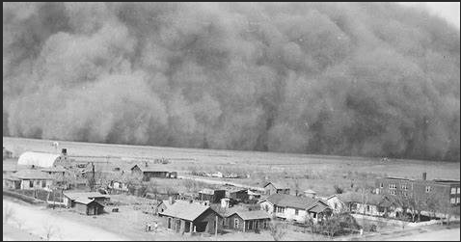
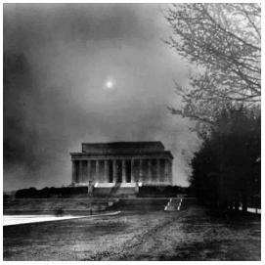
Who is NRCS?
Part of USDA
Established in 1933 as a result of the 1930s Dust Bowl
Voluntary, non-regulatory, technical and financial assistance to address resource concerns on private ag land.
  Farms, ranches/rangeland, & forests

Slide 3
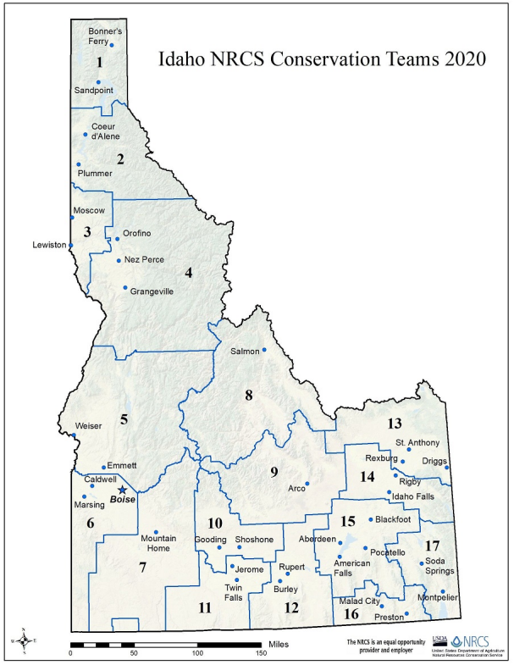
Where is NRCS-Idaho?
State Office, Boise
  Programs
  Technical Services
  Public Affairs
  Engineering
  GIS
Field Offices (17)
  Conservation Planners
  Engineers

Slide 4
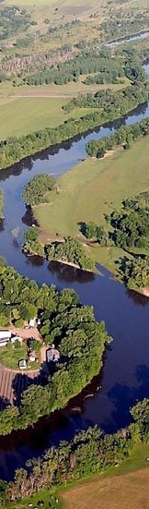
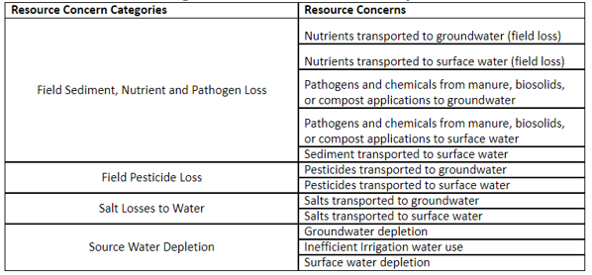
What are Resource Concerns?
SWAPA + E and H
Soil + Water + Air + Plants + Animal + Energy & Humans
For water:

Slide 5
How are SWAPA+HE Resource Concerns addressed?
Conservation Practice Standards (58)
  Guidelines for planning, designing, installing, operating and maintaining conservation practices.
  Programs and initiatives designed with suites of practices to best address specific resource concerns.
  NRCS staff will assess and identify the best way(s) to improve the condition of the resource.

Slide 6
NRCS’s Toolbox for Water Quality and Quantity Conservation

Slide 7
What is NRCS’s role in water protection?
Assist private agricultural lands (crop, grazing, forest) owners improve their land/address impacts from agriculture on water (surface and ground)
  Sediment & bacteria
  Excess nutrients
  Herbicides & pesticides
  Pathogens

Slide 8
Wholistic Approach
NRCS has many programs but first:
What would you like to see improved/how do you want your community/watershed(s) to look?
Then work with NRCS staff to determine which practices/programs/initiatives fit best.

Slide 9
NRCS Programs Improving Source Water
For landowners
  Environmental Quality Incentive Program (EQIP)
    Initiatives (higher cost share than general EQIP)
      Source Water Protection Priority Areas
      National Water Quality Initiative (NWQI)
For Watersheds/Communities
  Watershed and Flood Prevention Operations
  Resource Conservation Partnership Program (RCPP)
  WaterSmart (collaboration with BOR)
  Conservation Innovation Grants (CIG)

Slide 10
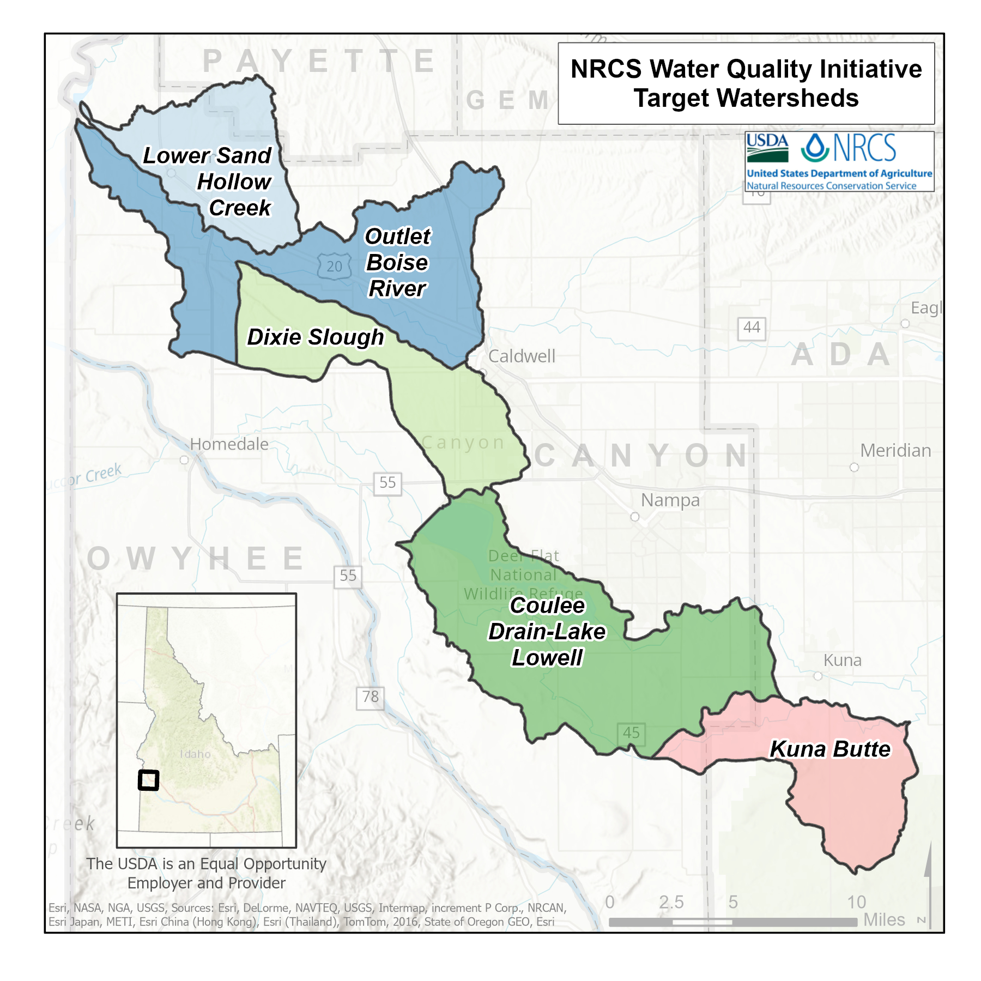
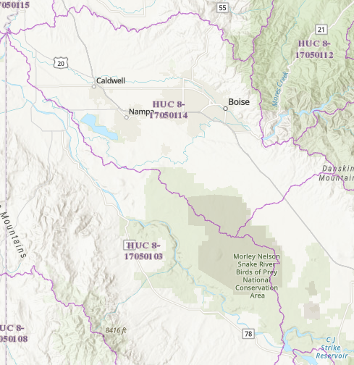
HUC-12 Level Watershed
20,783 acres
39,881 acres
Lower Boise Watershed - 850,233 acres; 3,441 sq. mi.
25,731 acres
51,331 acres
Middle Snake-Succor Watershed - 1,498,753 acres; 6,065 sq. mi.
23,807 acres
Notes:
HUC8 v. HUC12 = subbasin vs. local subwatershed; TMDL Implementation Plans at HUC-8 vs. NWQI at HUC-12 (10,000-40,000 acres)

Slide 11
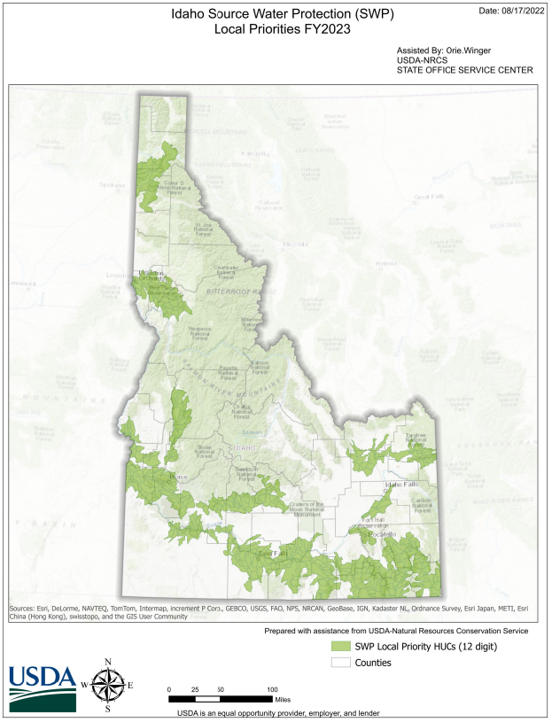
FY23 Priority Areas
Subwatersheds in Nitrate Priority Area (DEQ) or Groundwater Management Area (IDWR)
Meets 20% threshold (10.7 million acres)
    Public water systems quality & quantity at risk
    Private wells captured
https://nrcs.maps.arcgis.com/home/item.html?id=4fb51574297c4a7e8c63df5a3d47d33d
Notes:
Selecting areas where agricultural land uses may impact source water (per National Bulletin):
Nutrients, sediments, pathogens, pesticides at watershed scale
Reported or likelihood of harmful algal blooms (HABs)
Water system violations – exceedance of MCLs
Size of population served by source water protection areas
Groundwater systems served by sole source aquifer
Known areas of aquifer depletion
Other risks that may impact source water:
Karst geology
Highly erodible soils
Degraded habitat
Livestock access to surface water
Wildfire risk
Impaired surface waters
Aquatic habitat

Slide 12
National Water Quality Initiative (NWQI)
Targeted impaired waters program with participation at the watershed level
Designed for watersheds with high level of interest in conservation
Planning & Implementation Phase
Approved HUC-12 Implementation Plan required for Implementation Phase

Slide 13
SWP Areas vs. NWQI
No limit to NWQI watersheds;
  NWQI has 42 core practices, 59 supporting practices+
  VS.
Limited number of eligible practices for SWP Areas (20);
  Area is limited to 20% of total state land mass (may exceed with a waiver)

Slide 14
Resource Conservation Partnership Program (RCPP)
Bear River Watershed Agriculture and Habitat Connectivity (2022)
Lead Partner: Bear River Land Conservancy
Lead State: UT
Partner States: ID, WY
Award: $7,850,000
Funding Pool: S/M
CCA (if applicable): N/A
Total Partner Contribution Amount: $15,150,639
Project Summary: The Bear River Watershed Agriculture and Habitat Connectivity project covers areas of Utah, Idaho, and Wyoming. Bear River Land Conservancy and a coalition of over ten partners plans to combine conservation easements and land management activities to protect and connect terrestrial, riparian, and aquatic habitats and to preserve working lands as a viable component of the landscape. A sophisticated geospatial analytical tool will be used to target project funding to areas with the highest conservation value.
Promotes coordination of NRCS conservation activities with partners to multiply conservation investments and reach common goals at the farm, watershed, and regional scale.
  Streamlined in 2023 based on partner feedback

Slide 15
Watershed & Flood Prevention Operations Program (aka PL-566)
Flood Prevention (Flood Damage Reduction)
Watershed Protection
Public Recreation
Public Fish and Wildlife Habitat
Water Quality Management
Agricultural Water Management
Municipal and Industrial Water Supply
Public Sponsorship
Watershed projects ≤ 250,000 acres
Ag benefits, including rural communities must be ≥ 20% of the total benefits

Slide 16
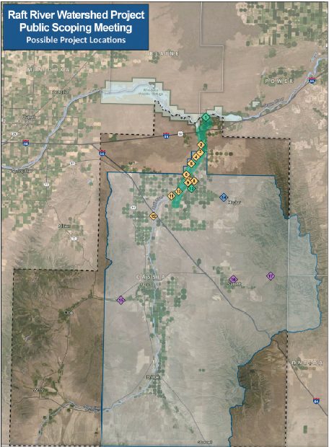
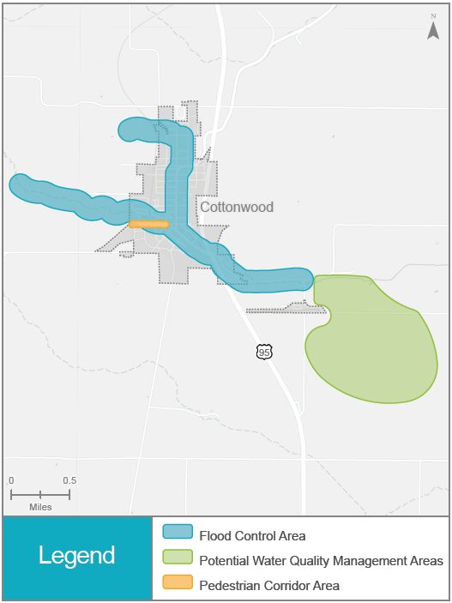
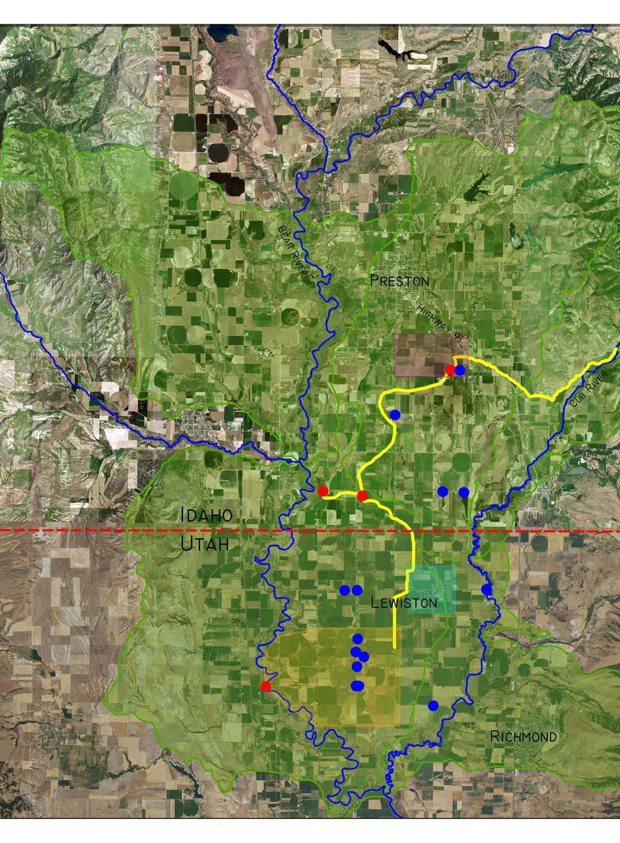
Currently Funded and in the planning phase
  N. Cache Valley (Cub River)
  Raft River
  City of Cottonwood
    Undersized and aged piping cannot handle peak flows, resulting in flooding of areas near the fairgrounds and along King and Main Streets during flooding events
    Treated water discharge from the wastewater lagoons to Cottonwood Creek does not satisfy State & Federal water quality standards
Notes:
Idaho Water Infrastructure and PL-566 | Natural Resources Conservation Service (usda.gov)

Slide 17
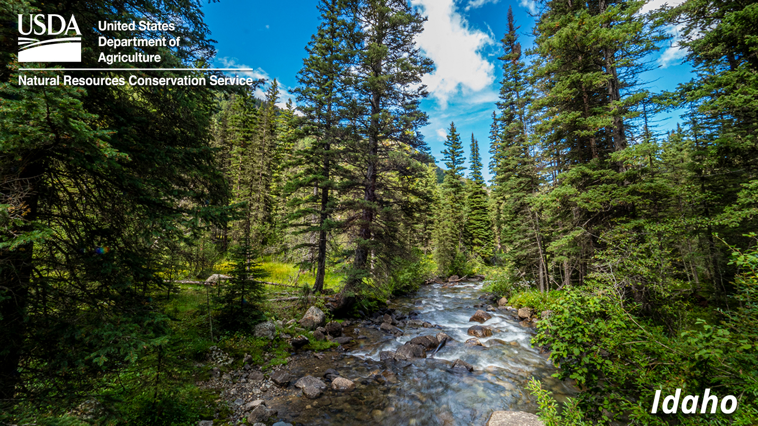
QUESTIONS?
Maureen Pepper
208-378-5723 maureen.pepper@usda.gov
Idaho | Natural Resources Conservation Service (usda.gov)

