Slide 1
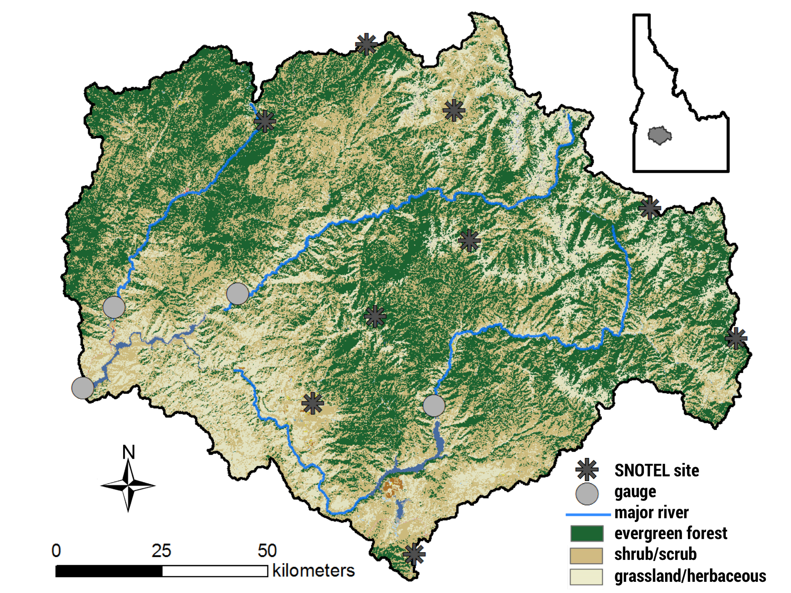

Boise State Research in the Upper Boise Basin
Kendra Kaiser
kendrakaiser@boisestate.edu

Slide 2
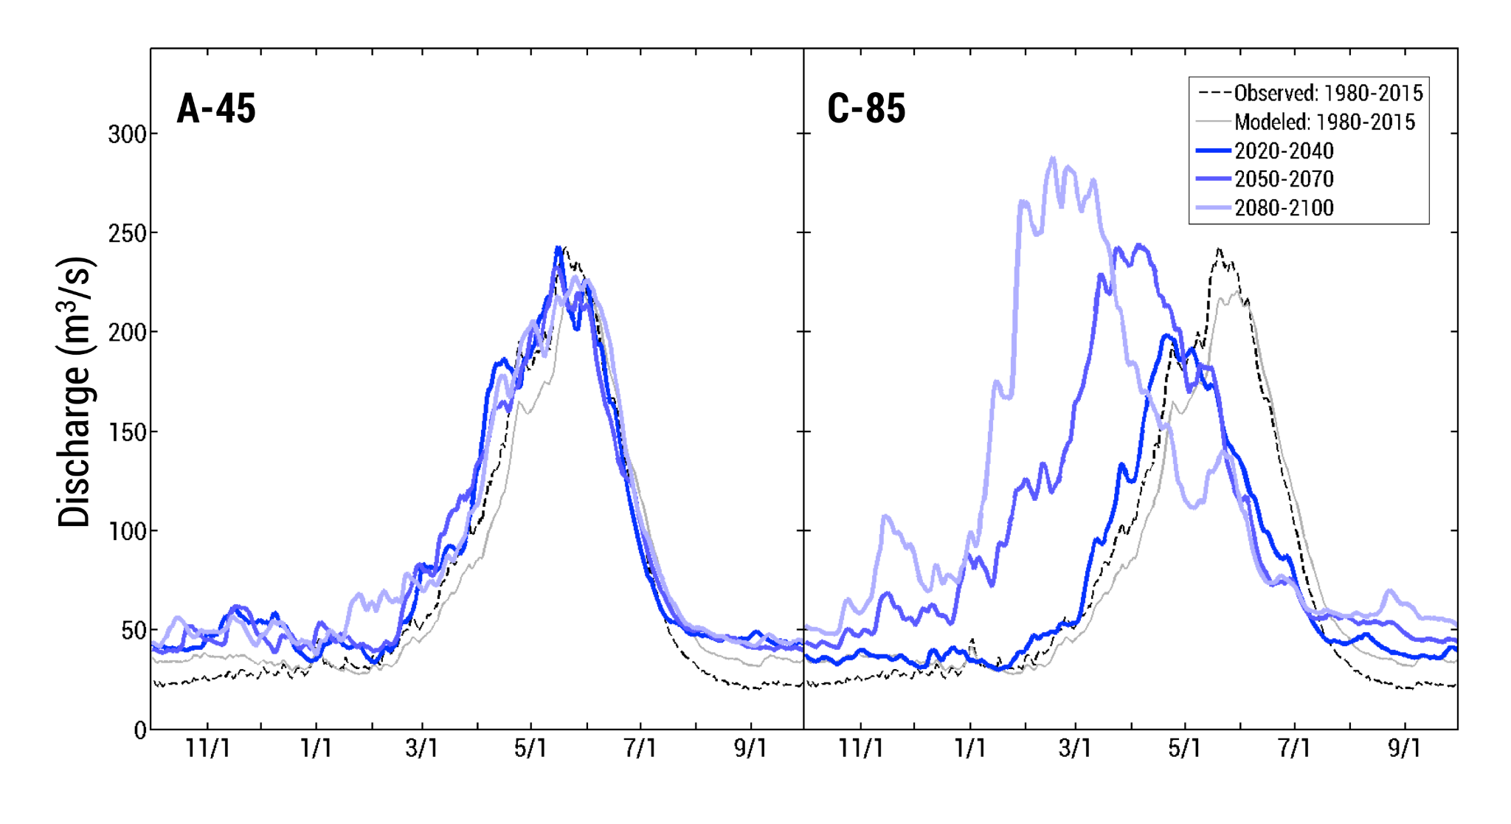
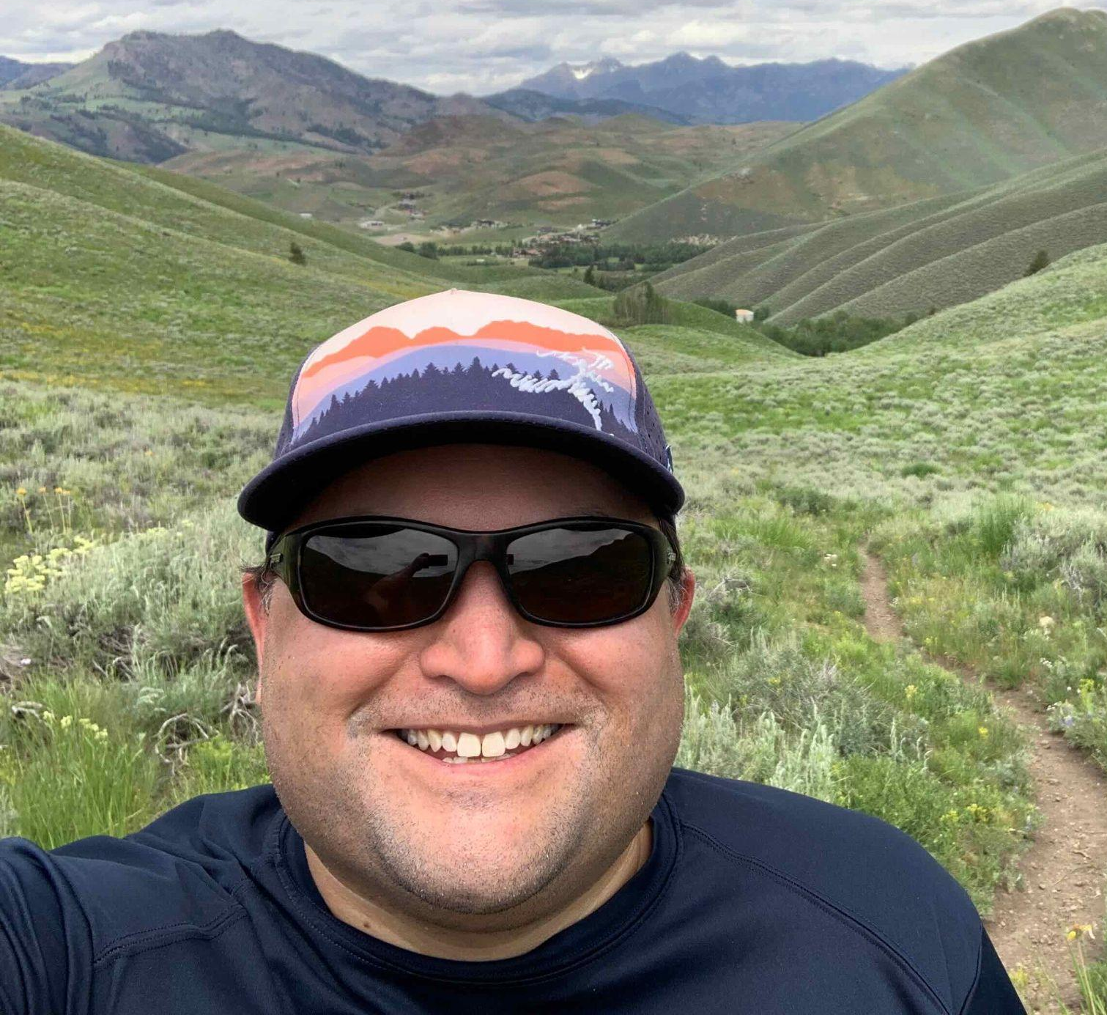
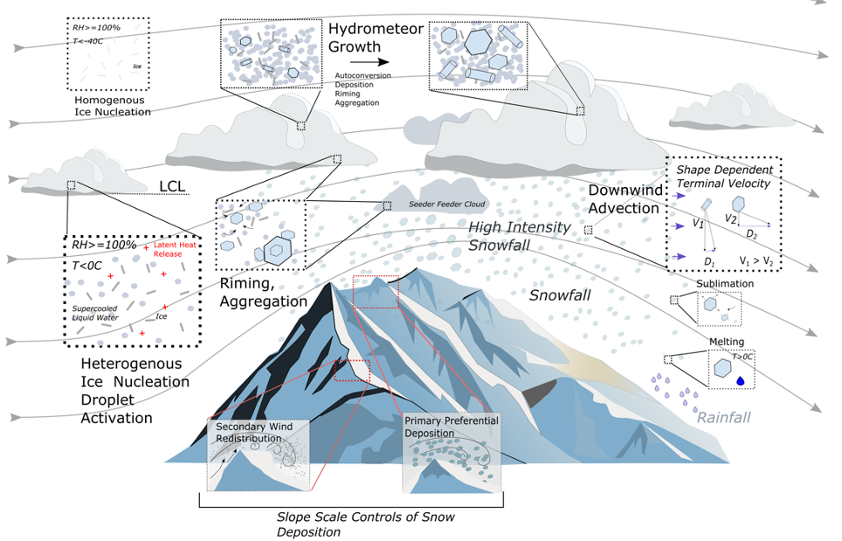
Lejo Flores
Tools/Data
Regional climate models - High-resolution historical climate for Southern Idaho
Hydrologic prediction models: Calibrated physically based model for Upper Boise
Climate and hydrologic projections for UBB
Interests:
How is the rain-snow transition changing?
How well are we predicting and observing precipitation phase and its change?

Slide 3
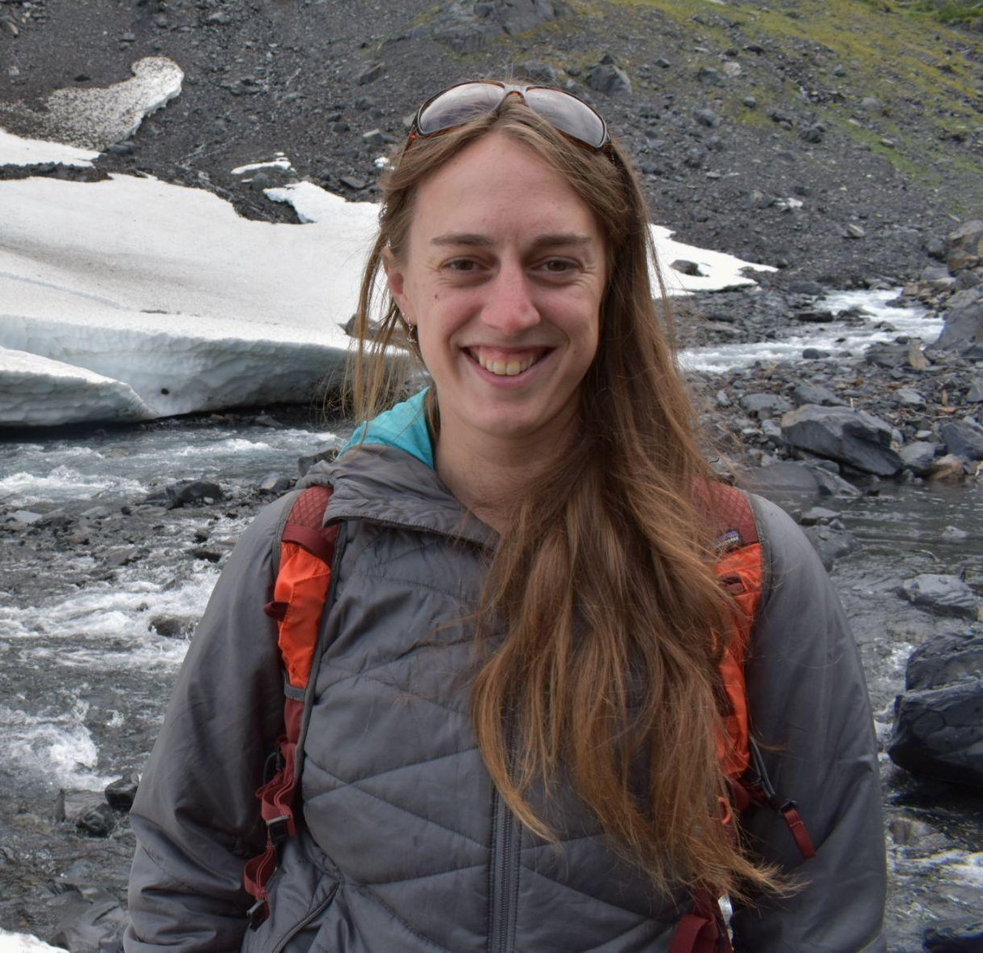
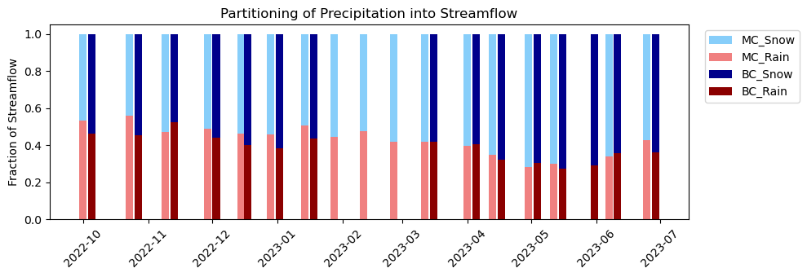
Anna Bergstrom
Biogeochemistry & Watershed hydrology
Impact of shifting rain-snow transition on relative proportion of seasonal precipitation
Impacts on nutrient exports and water quality
Mores Creek
Bannock Creek (Idaho City)
Notes:
SW- GW connections

Slide 4
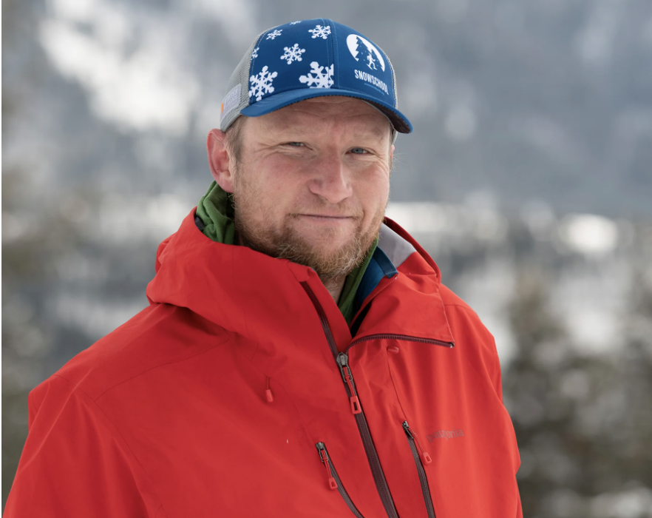


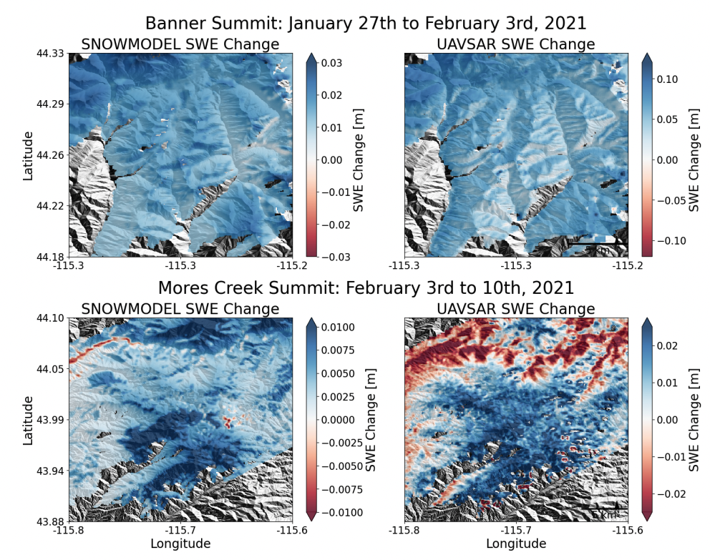
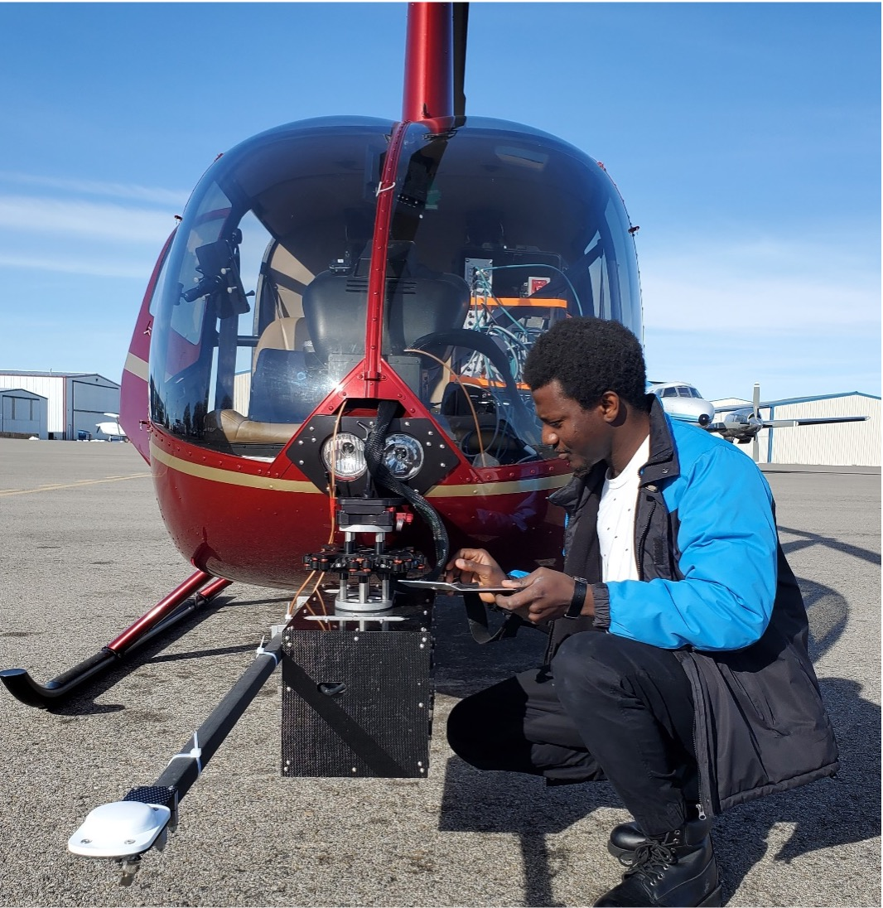

HP Marshall
Airborne snow remote sensing (LiDAR & Radar)
Ground based instrumentation
High Resolution Snowpack Modeling
CRRELHelipod - BSU PhD Student Naheem Adebisi installs and tests the lidar system before he performed a survey over Mores Creek Summit
SnowmodelUAVSAR - Zach Hoppinen's PhD work comparing L-band InSAR retrievals (UAVSAR, right) to physics-based snowpack model (SnowModel, left, 100m resolution)

Slide 5
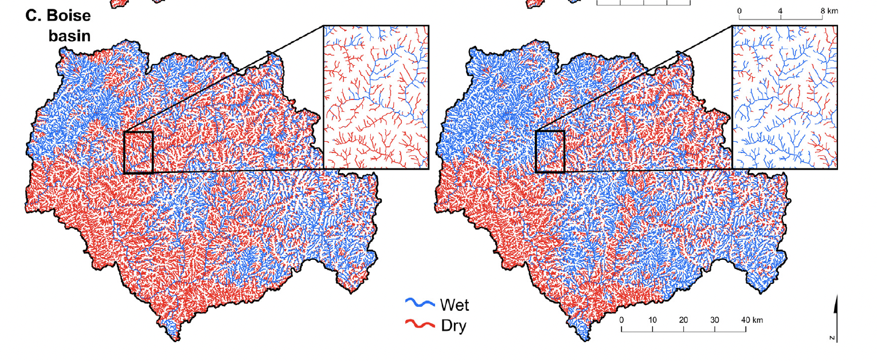

Kendra Kaiser
Data Harmonization & Visualization
Streamflow forecasting
Water rights & water management modeling
2004
2011
Streamflow Permanence Modeling - PROSPER

Slide 6
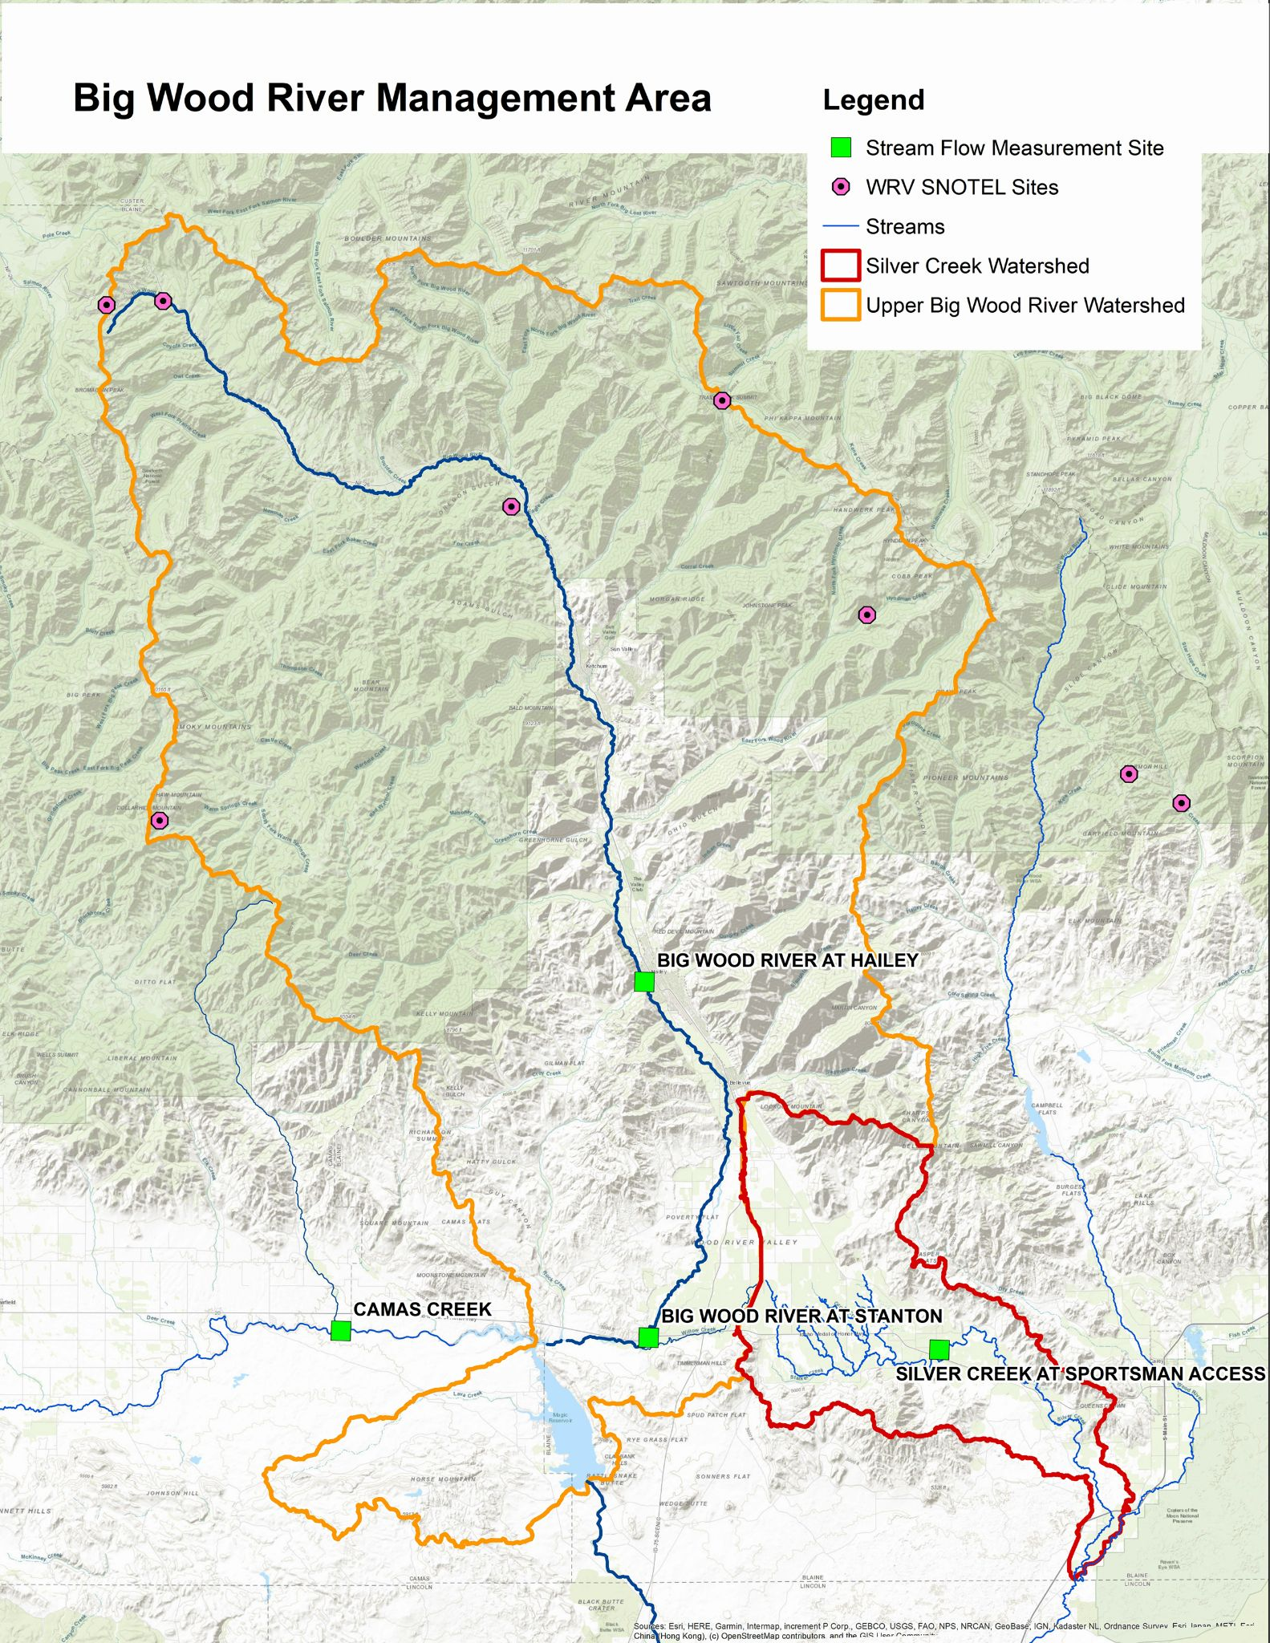
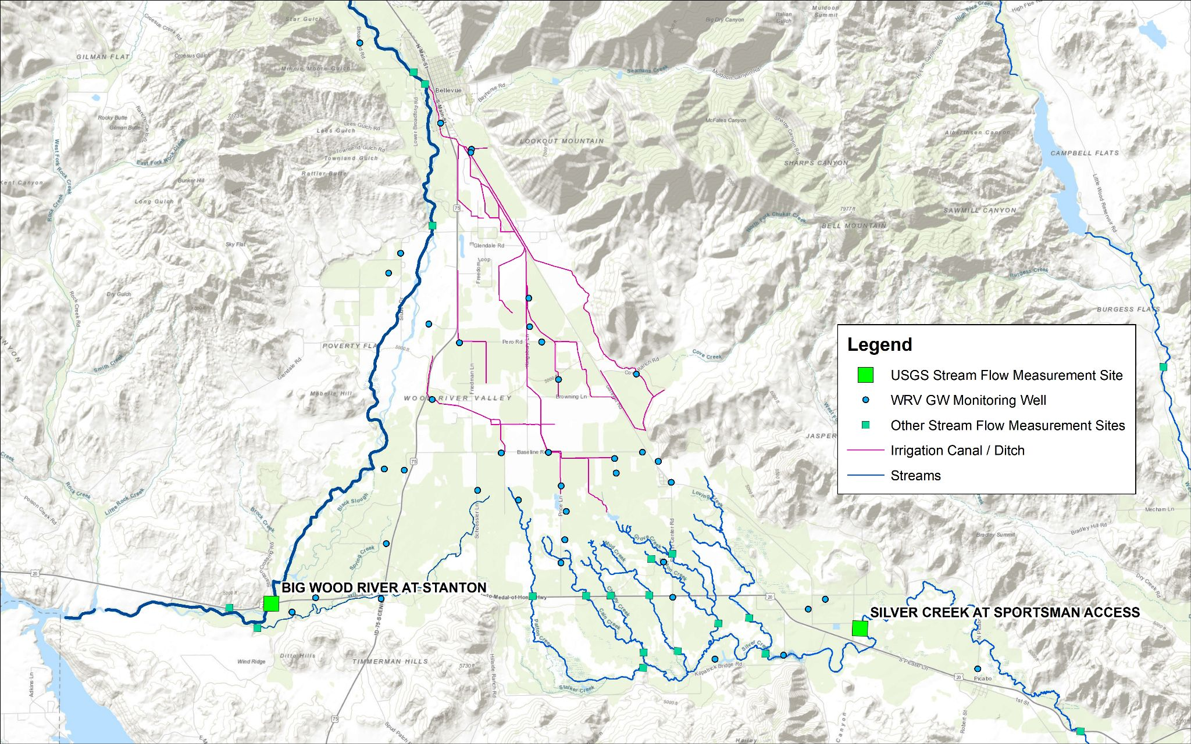







Vision
Big Wood River
Easily accessible and useful water data and water forecasting tools for the Wood River Valley.

