Slide 1
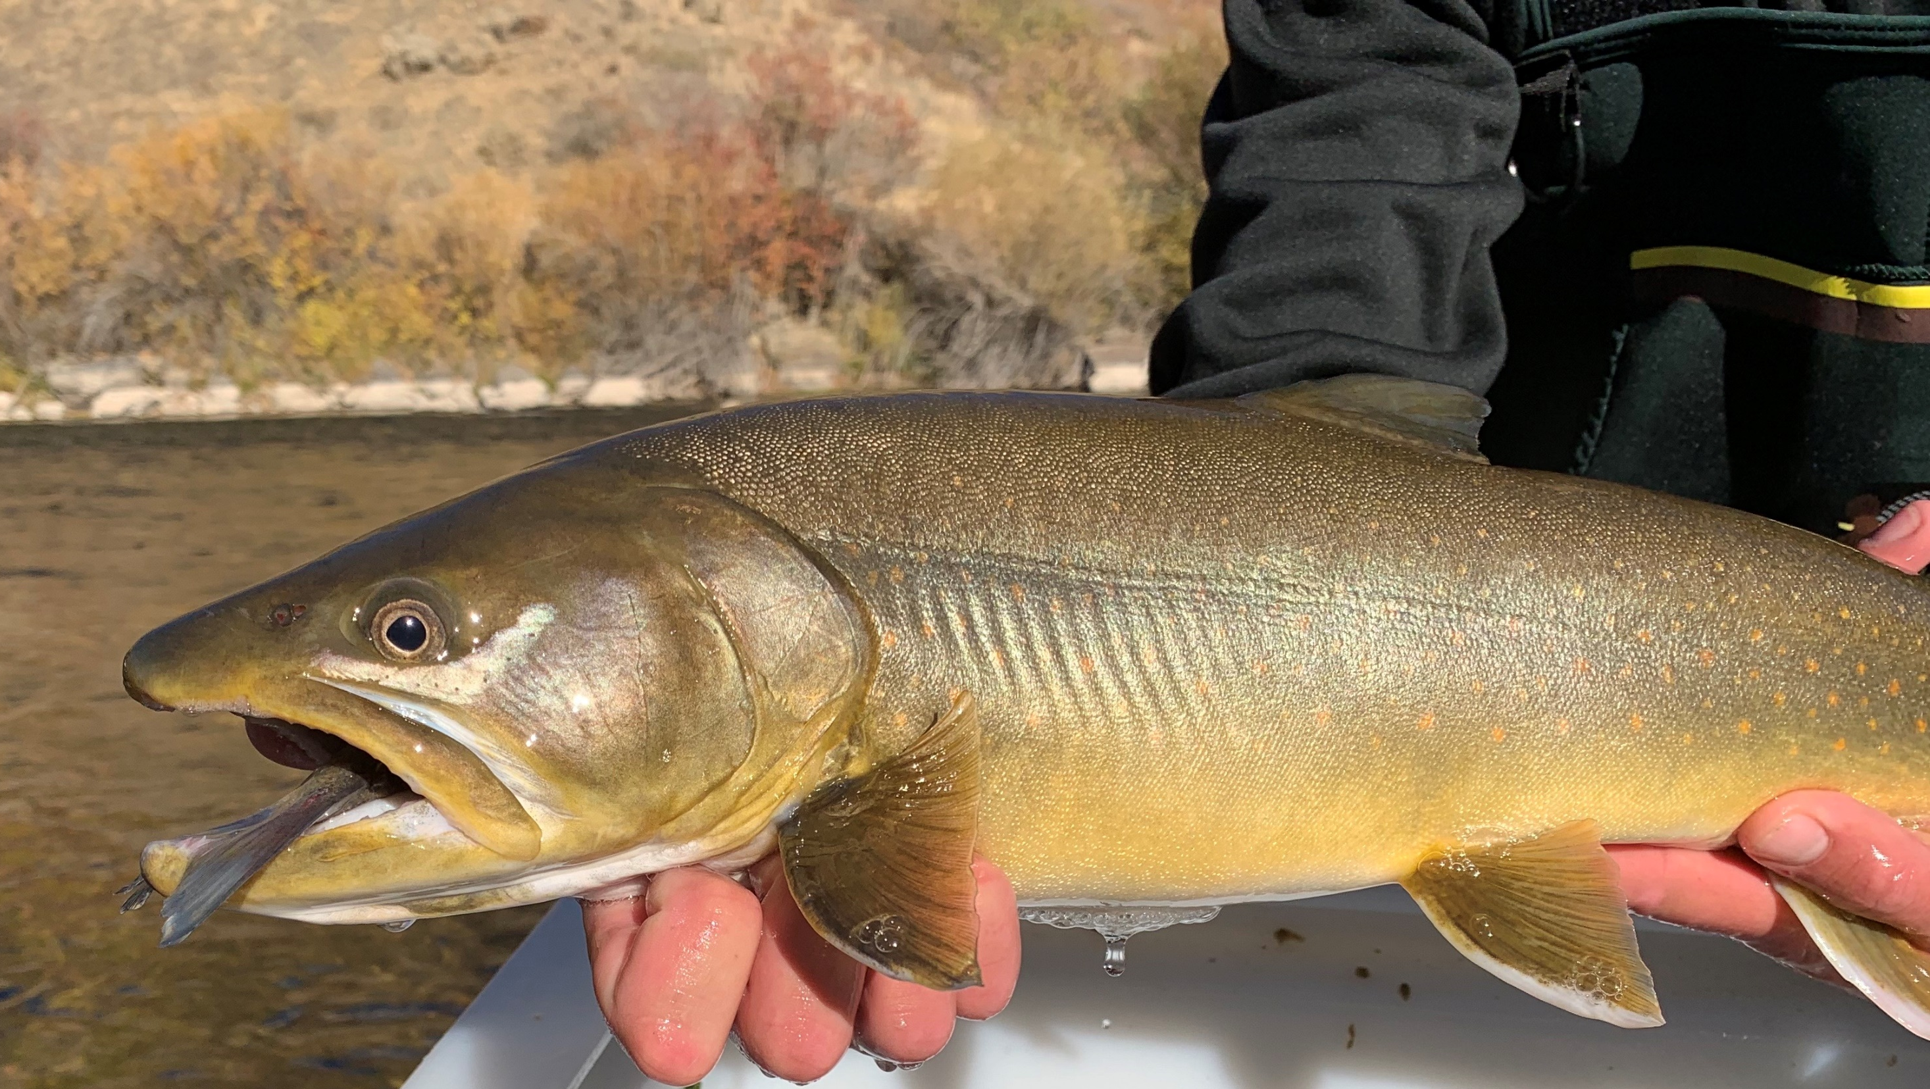
Salmonid Population Trends in Idaho’s South Fork Boise River
Timothy D’Amico – Idaho Department of Fish & Game
Notes:
Thank you for the introduction. Today I will be presenting some work we have conducted in the region on one of our premier trout fisheries, the south fork boise river.

Slide 2
Presentation Outline
Background
Site Description
Historic Context
Monitoring Efforts – Past & Present
Results
Discussion
Notes:
I’ll start with a quick presentation outline, describe the south fork boise and give you some historic context, talk about our monitoring efforts, both past and present, and then present results and finish with a short discussion

Slide 3
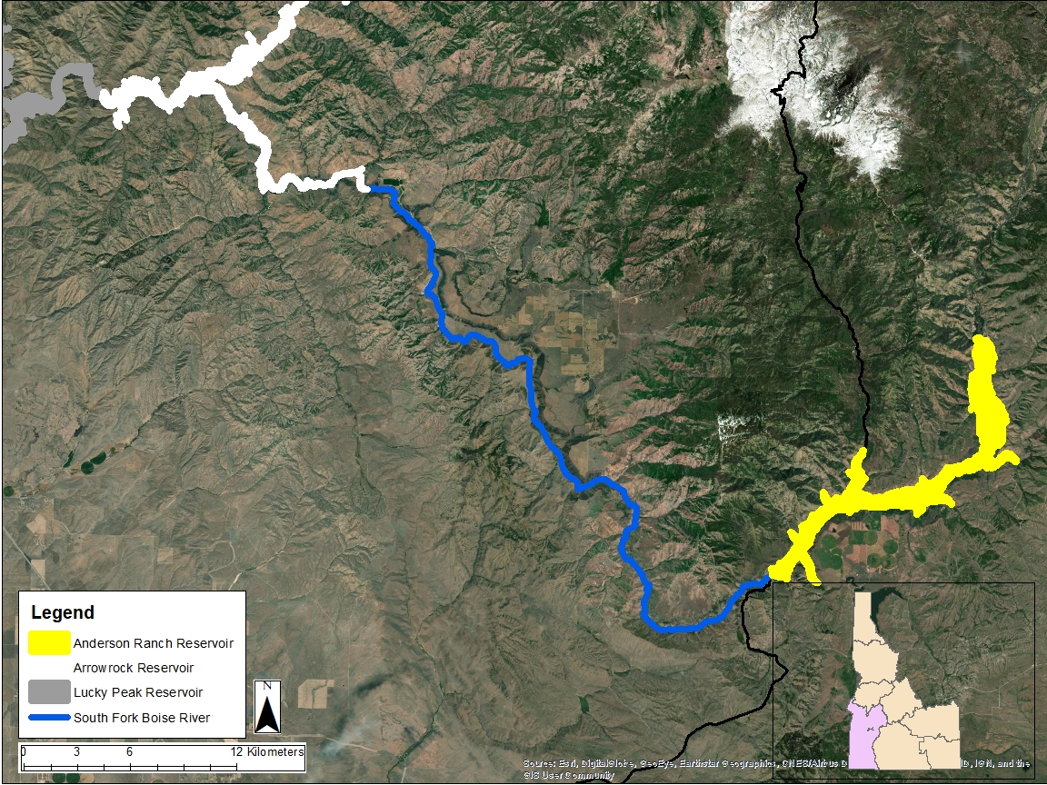
Notes:
For those who are unfamiliar, the south fork boise river is in southwest Idaho. It spans two IDFG regions, Magic Valley and Southwest (shown by the black line). The headwaters of the SFBR are in the Sawtooth National Forest, and it flows southwesterly into Anderson Ranch Reservoir shown in yellow. Below Anderson Ranch Dam is where the south fork boise river enters the Southwest Region (shown in blue). Eventually, the SFBR flows into Arrowrock Reservoir (shown in white).

Slide 4
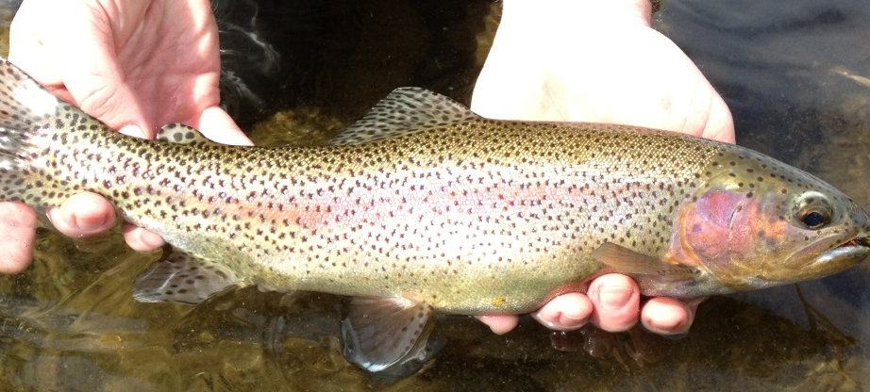
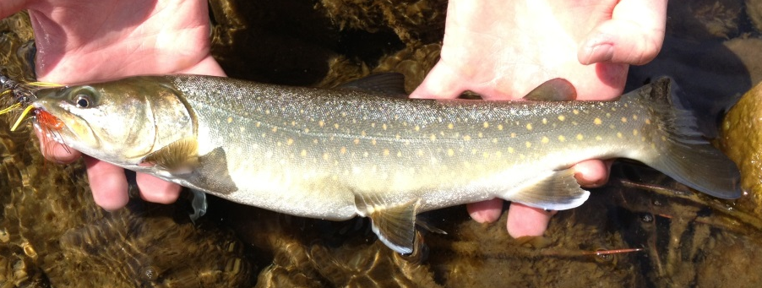
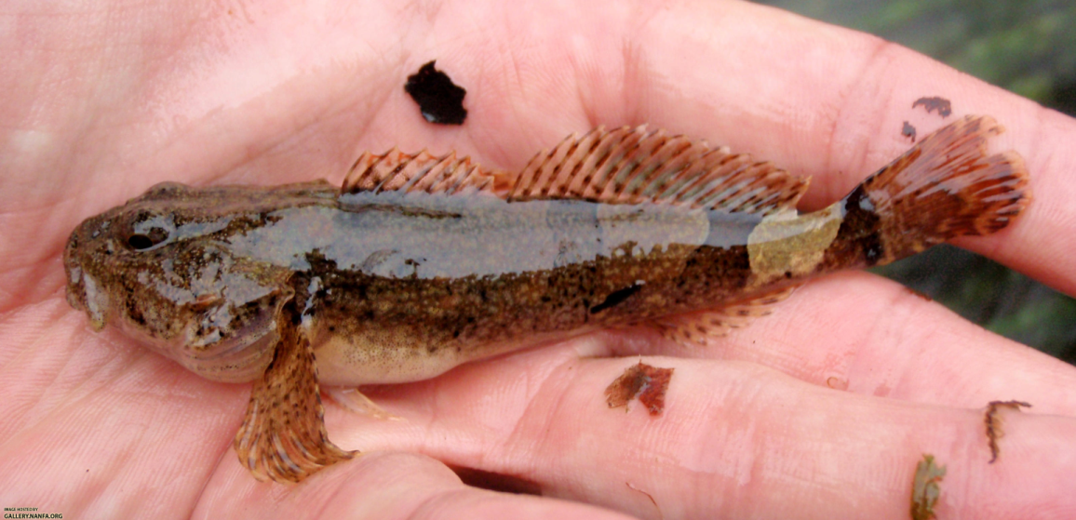
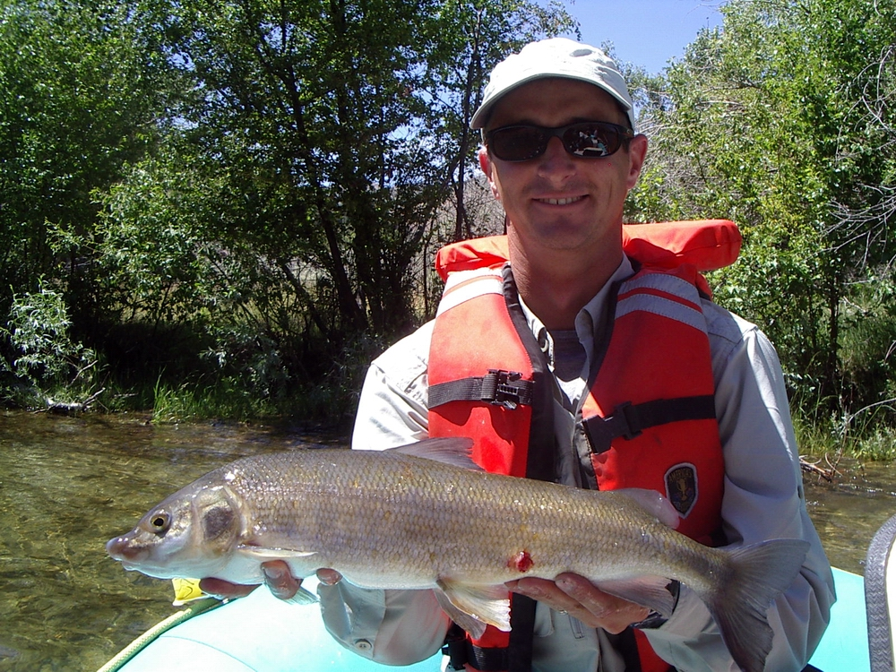
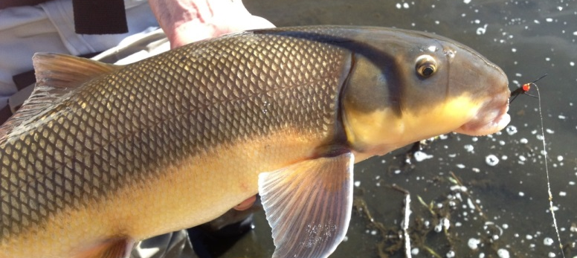
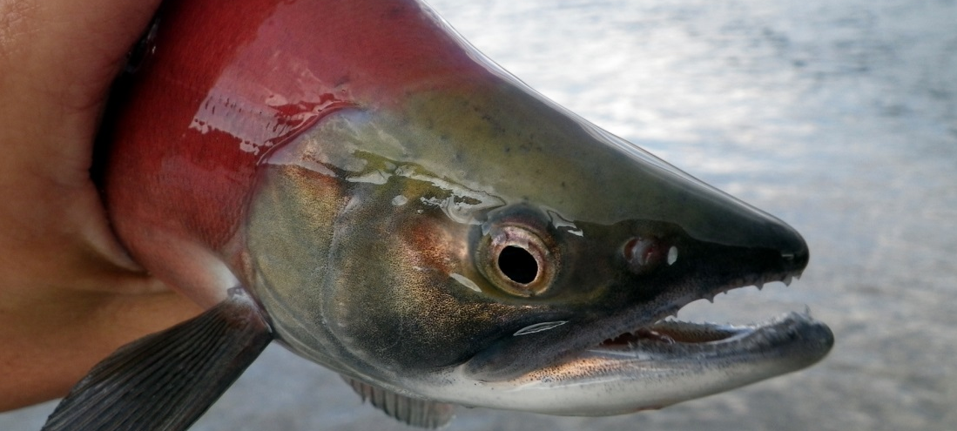
Fish Community
Notes:
The South Fork Boise River between Anderson Ranch Dam and Arrowrock Reservoir was the first designated quality trout stream segment in southwestern Idaho, and remains the premier
wild trout fishery here. Rainbow Trout and Mountain Whitefish make up the majority of the fishery. We also have bull trout, both resident and adfluvial fish that migrate up out of Arrowrock Reservoir as well as a few nongame fishes, such as sucker and sculpin species.

Slide 5
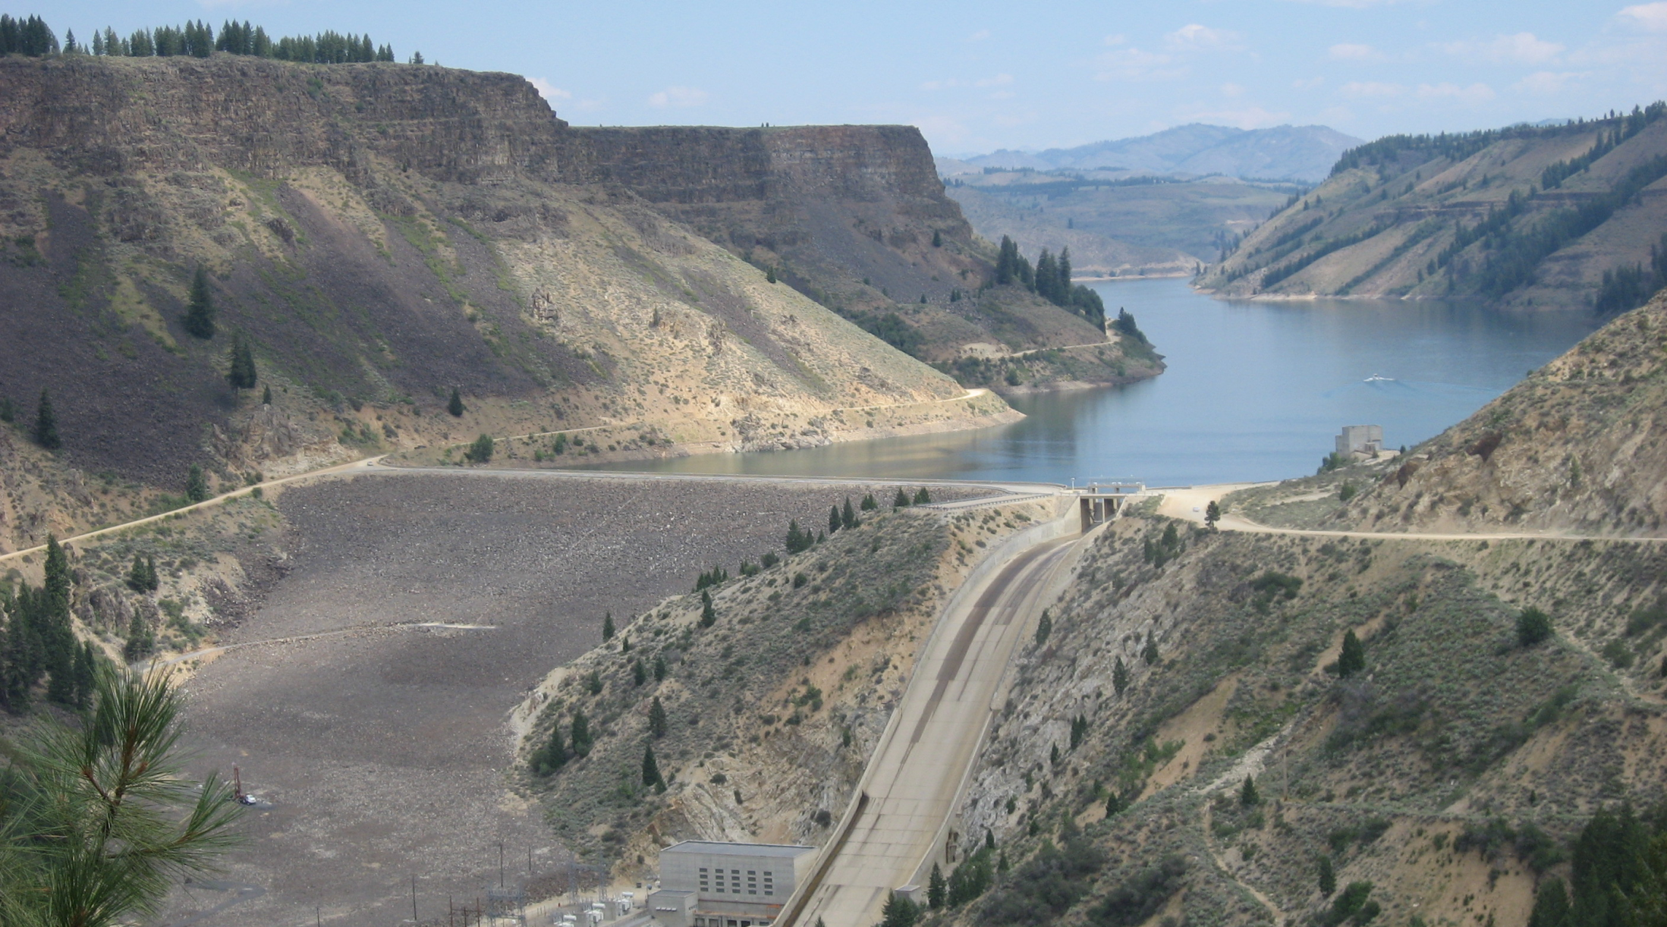
Anderson Ranch Dam
Notes:
A little history on Anderson Ranch Dam; it was part of the Boise project, completed between 1941 and 1950. it is 456 feet tall with a hypolimnetic release. When it was completed in 1950, it was the tallest dam of its kind in the world. The primary purpose of Anderson ranch dam is as a irrigation storage facility, but also provides hydropower. Originally it was designed to create 27 megawatts, has since been upgraded to provide 40 megawatts. Below Anderson Ranch Dam, the SFBR has a winter flow target of approximately 300 cfs.

Slide 6
History - Regulations
1977 - 1980 3 trout, ≥ 12”
1981 3 trout, ≥ 13”
1982 - 1991 3 trout, < 12” + 1 ≥ 20”
1992 - 2001 2 trout, 12-20” slot
2002 – Now 2 trout, ≥ 20”
2011 - Seasonal closure (April 1 – Memorial Day)
Notes:
The SFBR has had a number of different regulations overtime, starting with liberal regulations in the late 70s and as you can see, getting more restrictive through time. In 2011, the SFBR received a seasonal closure to protect spawning Rainbows, one of three such regulations in the state.

Slide 7
History - Stocking
Ceased SFBR stocking 1976
~ 15,000 Rainbow Trout / year prior
Current
Arrowrock
~100,000 kokanee
~15,000 Rainbow Trout
Anderson Ranch
~ 150,000 kokanee
Varying Rainbow Trout
Notes:
Currently, the SFBR functions as a wild trout fishery, however prior to 1976 it received approximately 15000 fish annually. However, the adjacent reservoirs receive varying levels of stocking. Arrowrock reservoir receives approximately 100,000 kok annually, as well as approximately 15,000 triploid rainbows. Anderson Ranch typically receives between 100 and 200k kokanee, and varying levels of RBT. Prior to 2020, Anderson Ranch had not been stocked with RBT since 2014.

Slide 8
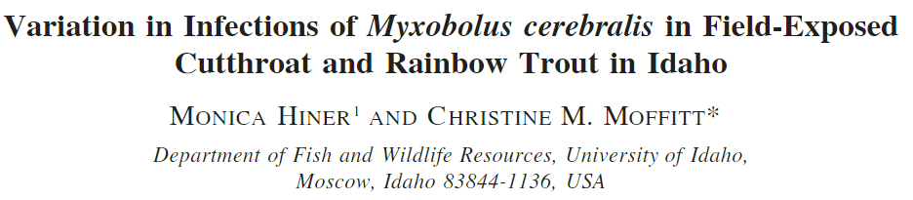
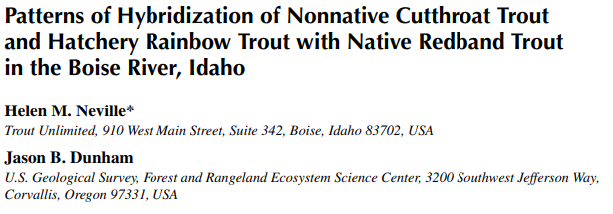
History - Research
Notes:
The SFBR has also been the focus of several peer-reviewed papers, including early evaluations on flow reductions and the associated impacts on aquatic invertebrates. A 2001 study out of University of Idaho looked at distribution and variation of infection of whirling disease in cutthroat and rainbow trout (SFBR is WD-positive).
A 2011 study looked at genetics of trout in the SFBR, finding that SFBR fish are mostly coastal rainbow trout genetics, rather than the native redband strain. Authors noted that at the time of publication, the SFBR has not been stocked in over 30 years (now 40 years), but they hypothesized the heavy reservoir influence may play a role in the domination of these coastal rainbow genetics compared to the native redband.

Slide 9
History - Surveys
Periodic creel surveys (early 2000s)
Tributary surveys (2011 – 2012)
Raft electrofishing (2012)
Fall fry sampling (2012 – 2016)
Spring age-1 estimates (2013 – 2015)
Triennial populations estimates (1997 – present)
Notes:
As a premier fishery, the SFBR has also received a lot of management attention, from creel surveys in the early 2000s, tributary surveys in the early 2010s, raft electrofishing the canyon reach, juvenile trout evaluations both in the fall and spring during the mid 2010s and also our triennial adult trout population estimates, which have been happening approximately every three years since 1997.

Slide 10
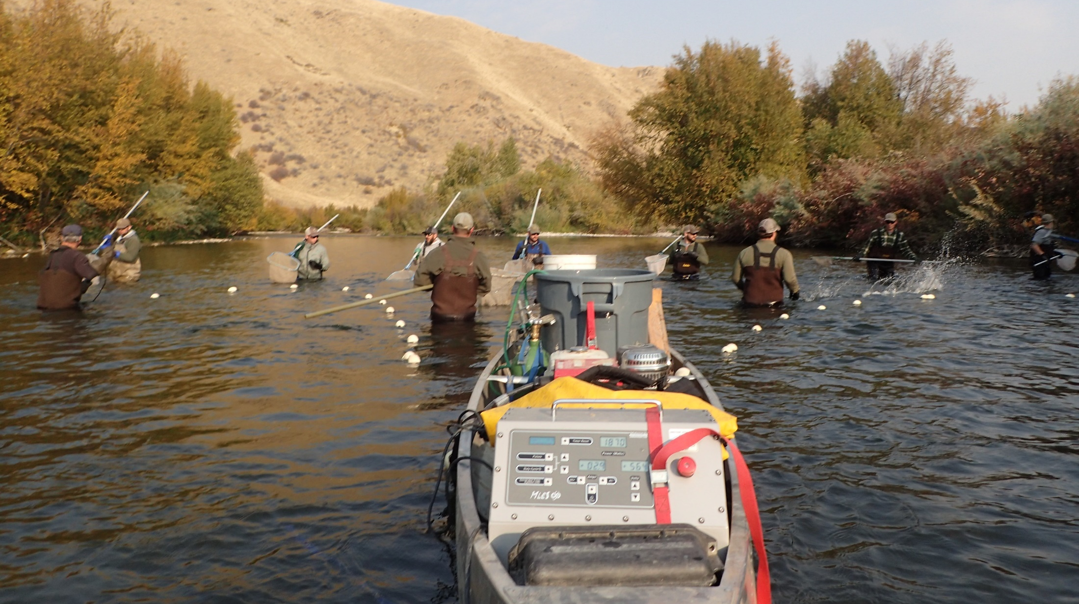
Survey Methods
Notes:
For those triennial adult trout population estimates, this is what our setup looks like. We have been using canoe-mounted electrofishing rig since 2006, with a third anode added in 2014. we float the canoe downstream, with three throw anodes and about a dozen netters. We have three reaches, upper middle and lower. Each reach is approximately 1 km long. During this survey, we capture all trout, and mark them with a hole punch in the caudal fin, and then return a week later to recapture fish and generate a population estimate.

Slide 11
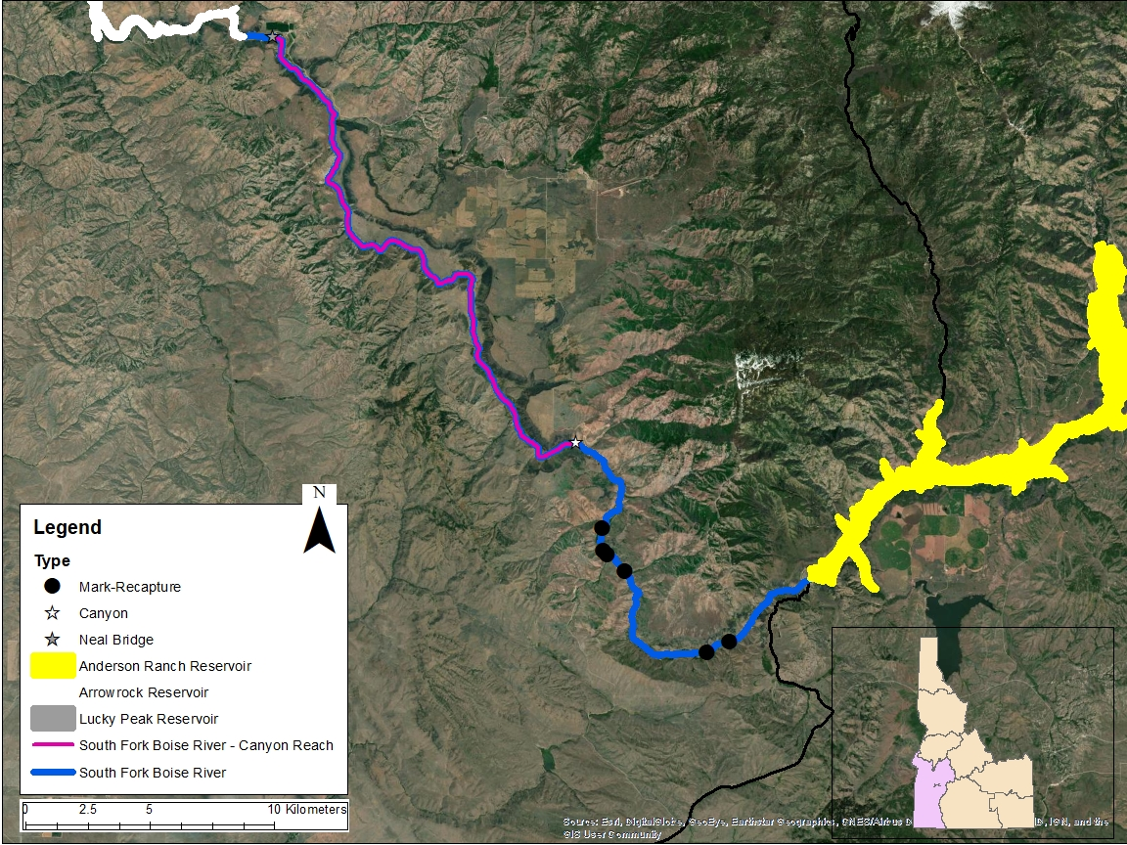
Notes:
Here is the same map, now with some slightly different features highlighted. There are two distinct sections, the roaded reach which you can see in the blue line, I have also overlaid the canyon reach in that pinkish color. The canyon reach starts at that white star, and ends at the takeout at Neal Bridge. The roaded section is very popular with anglers, both wade and float anglers. During most parts of the year, you can run a drift boat on the roaded section. The canyon reach has a few rapids that can get pretty tricky, and is more suited for a raft than a hard boat. The black dots are now the start and end locations of our three mark/recapture sites.

Slide 12
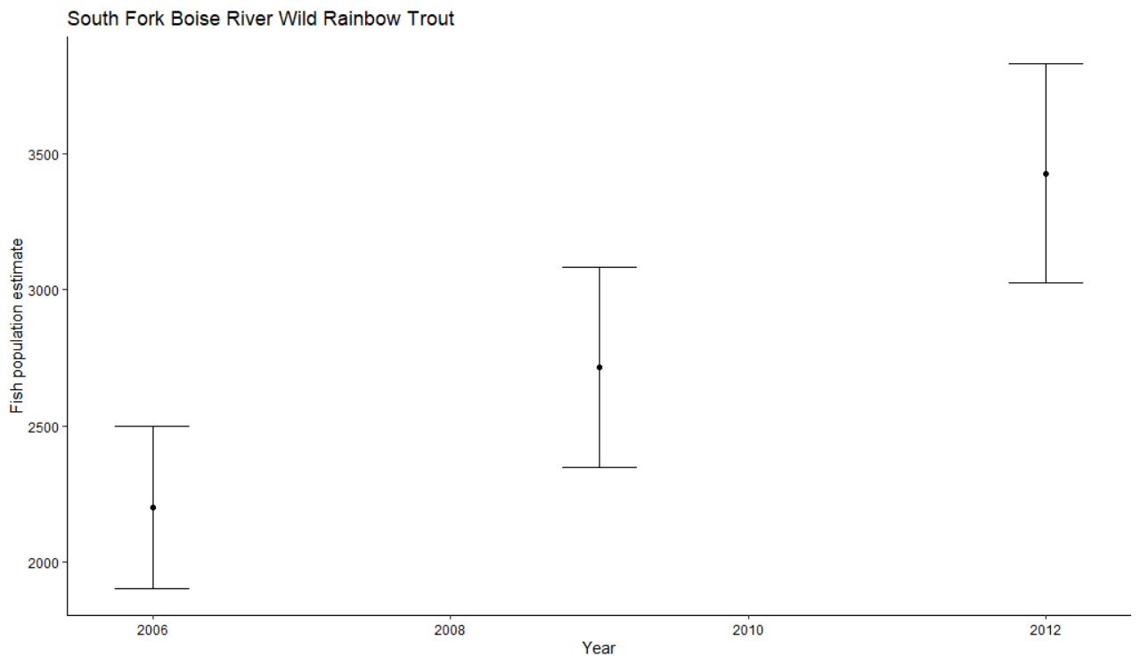
Notes:
So what have we seen in these mark/recapture surveys. On the x-axis is year, on the y axis is our fish population estimate generated from those mark/recapture experiments. From 2006 to 2012, we had a steady increasing trend in the population estimate, from about 2200 fish to almost 3500 fish in 2012, things were looking good.

Slide 13
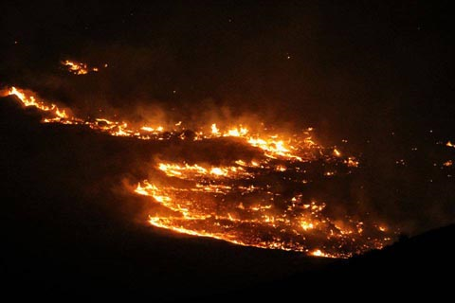
Pony/Elk Fire – 2013
Notes:
Then in August 2013, wildfire broke out. The Pony/Elk complex fire burned over 130,000 acres FAST. Pretty much nuked the entire uplands as well as the canyon. Then on top of the fire, severe thunderstorms lead to mud/debris slides in mid-September

Slide 14
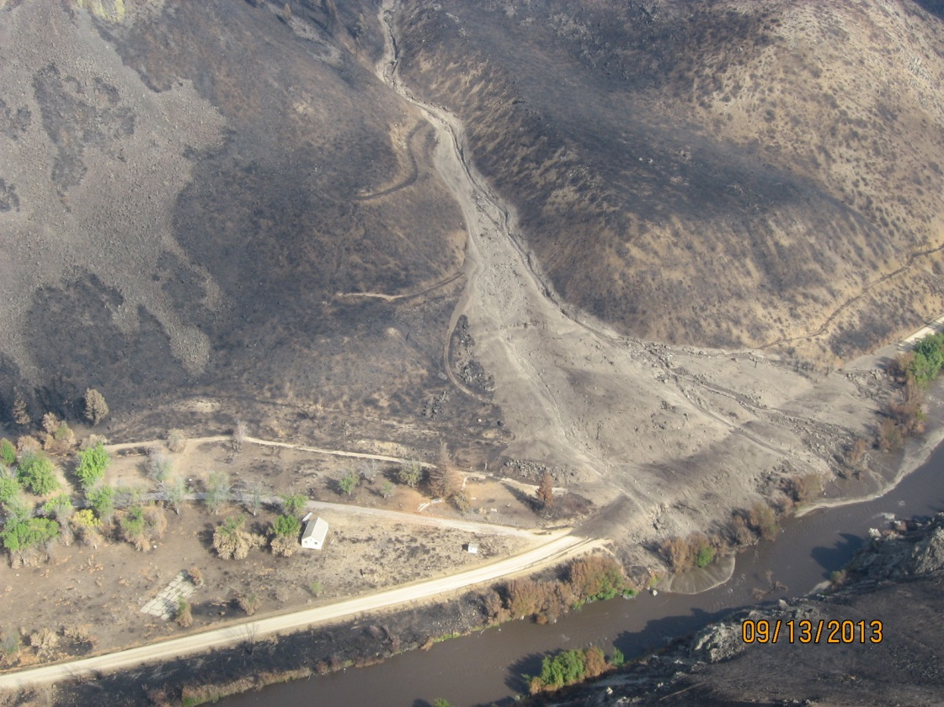
Reclamation Village – 2013
Notes:
Multiple debris flows in the roaded section, including near Reclamation Village
Rough Creek
Granite Creek
Pierce Creek
Cayuse Creek
Trail Creek
Several others

Slide 15
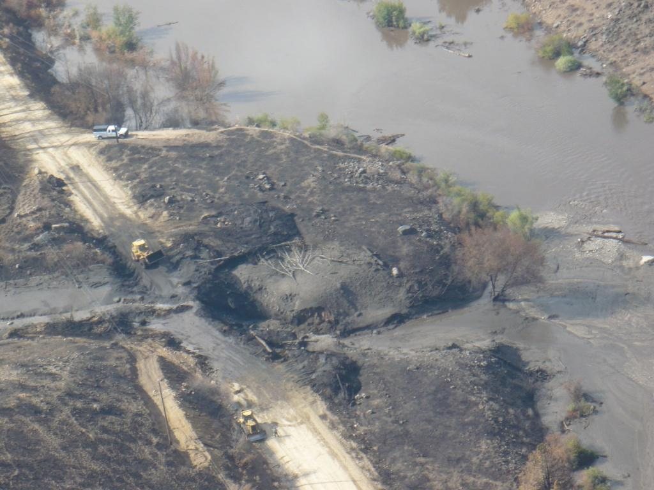
Granite Creek – 2013
Notes:
Granite Creek
Pierce Creek
Cayuse Creek
Trail Creek
Several others

Slide 16
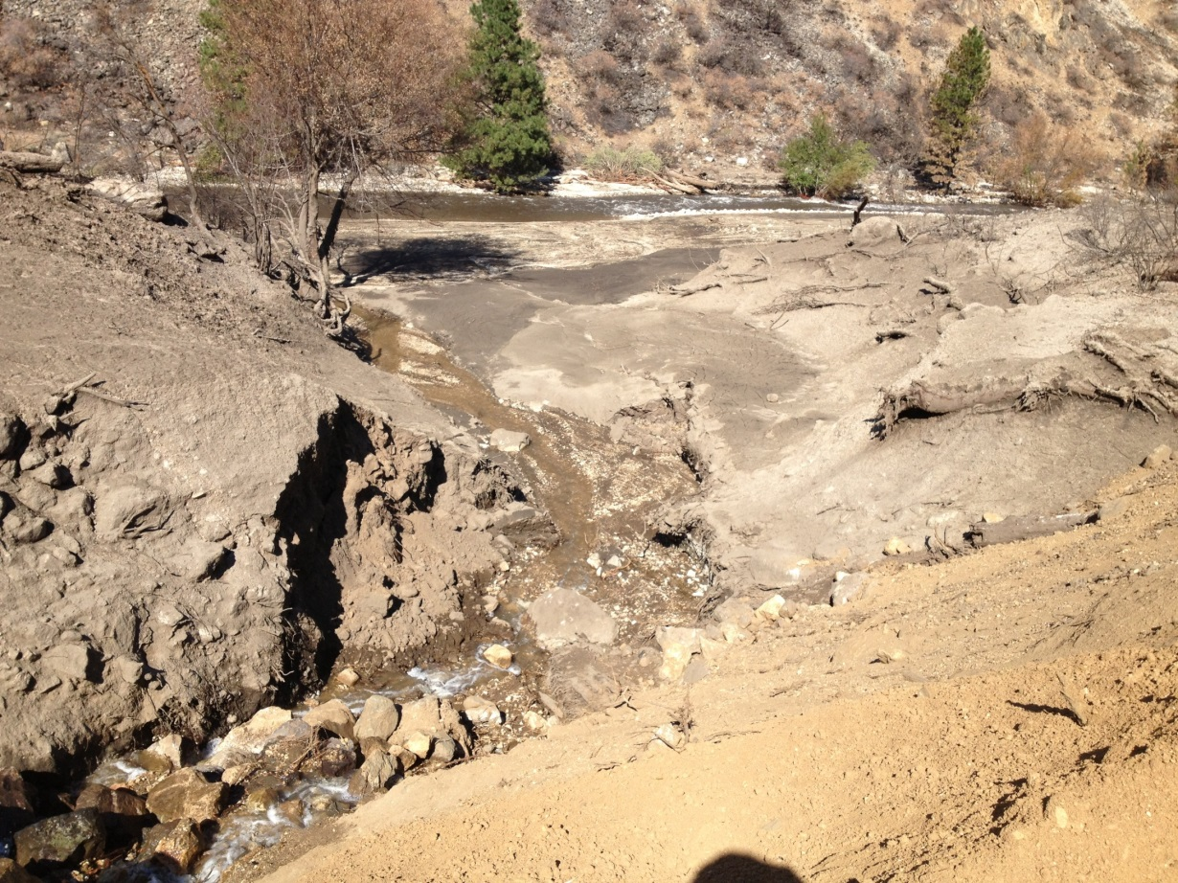
Pierce Creek – 2013
Notes:
Pierce Creek
Cayuse Creek
Trail Creek
Several others

Slide 17
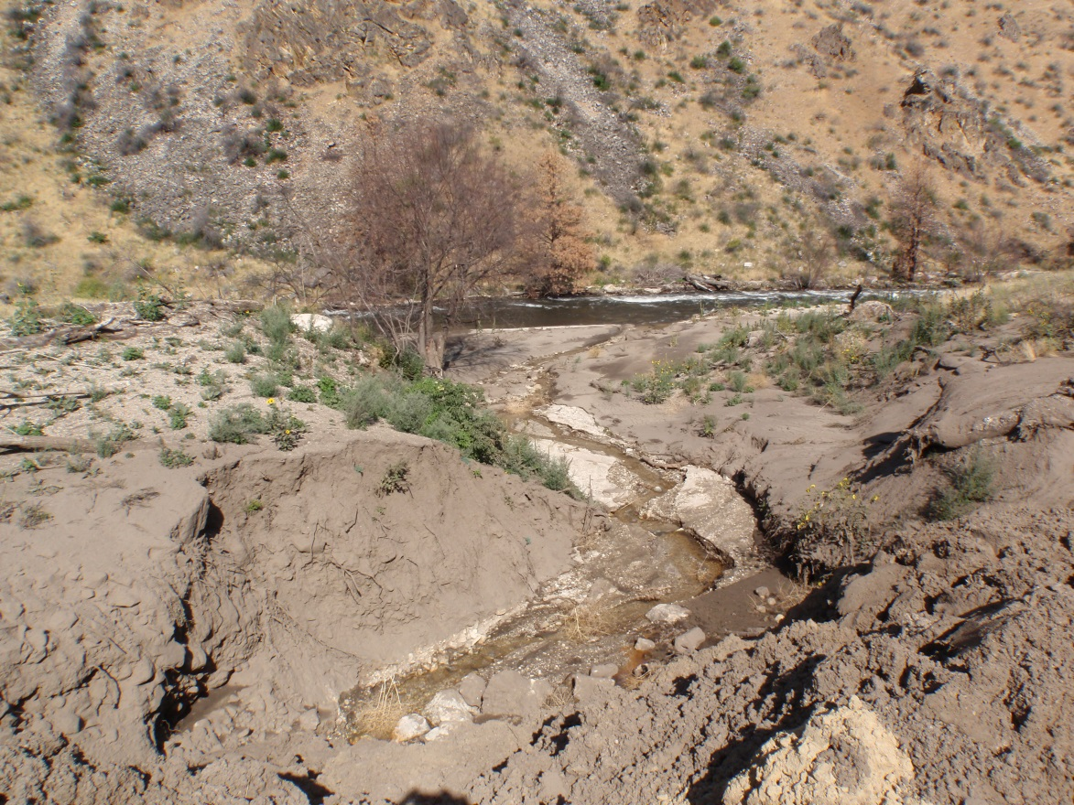
Granite Creek – 2014
Notes:
As if one year of debris flows wasn’t enough, in 2014 there were blowouts at many of the same sites, including Granite Creek

Slide 18
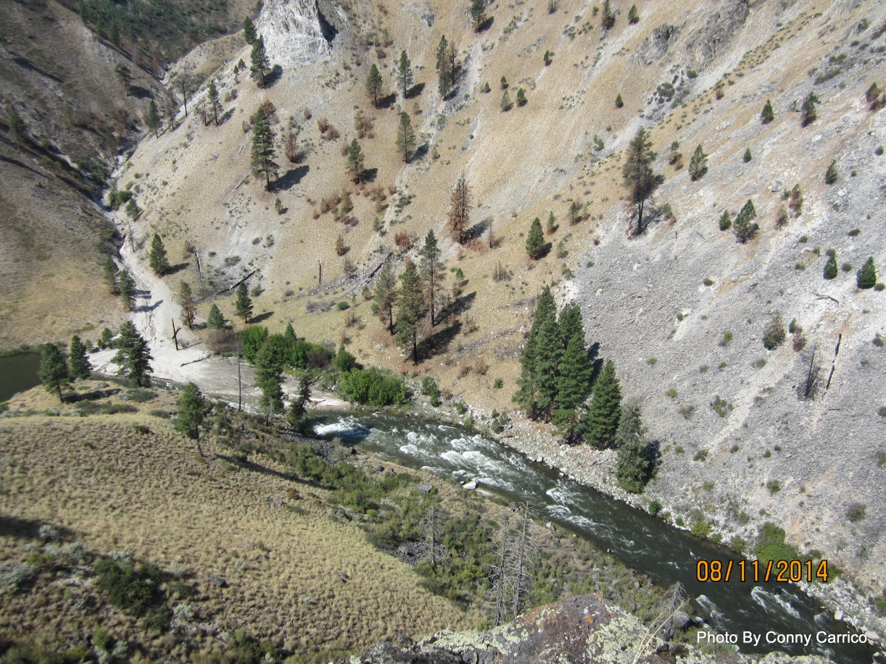
Pierce Creek – 2014
Notes:
Pierce Creek (Again!)
Devils Hole Creek
Little Fiddler Creek
Several others

Slide 19
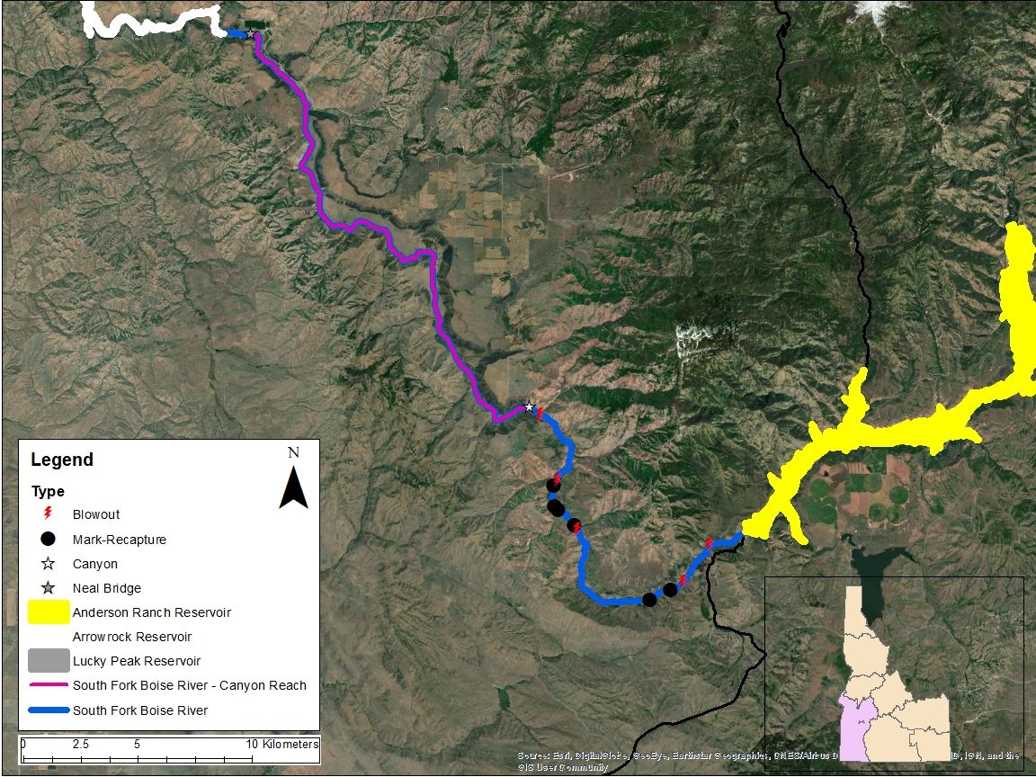
Notes:
So this is the same map as before, now with the locations of some of the major blowouts or debris slides during 2013 and 2014. You can see debris flows near almost each of our mark/recapture sites. There were plenty of them in the canyon, however I just displayed the ones in the roaded section.

Slide 20
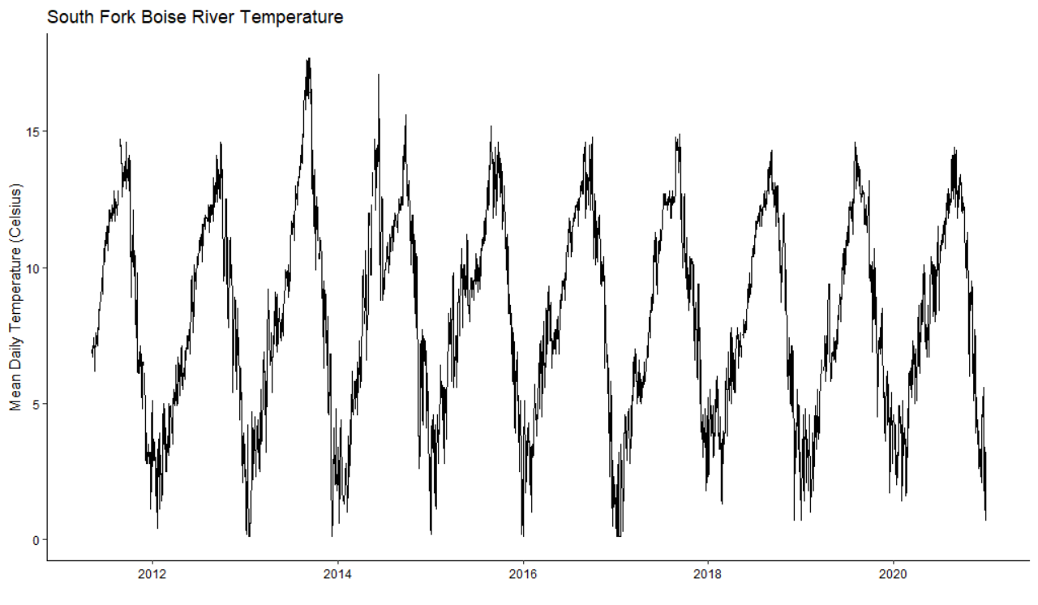
Notes:
Of course with the debris flow, we saw increased turbidity, and temperature spikes. This plot is mean daily water temperature since 2011 at Neal Bridge site (the bottom of the canyon reach).

Slide 21
Notes:
And you can see 2013 and 2014 directly post-fire and debris flows were some of the hottest recorded temperatures at Neal Bridge.

Slide 22
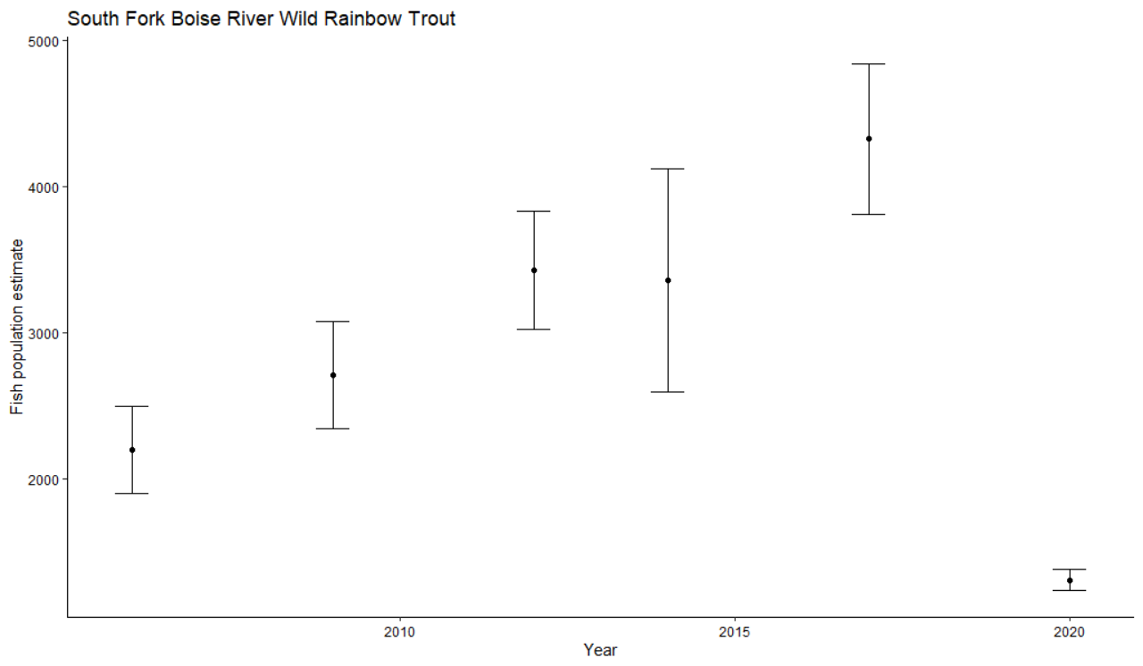
Notes:
What did that mean for the trout population following those fires and subsequent debris flows and temperature spikes? This is the same plot as earlier, year on the x axis and population estimate on the y axis, and you can see directly post fire (2014) we didn’t see much change in the point estimate, however the confidence intervals increased. In 2017, we saw a sizeable increase, where the population estimate was over 4000 fish, and then 2020….

Slide 23
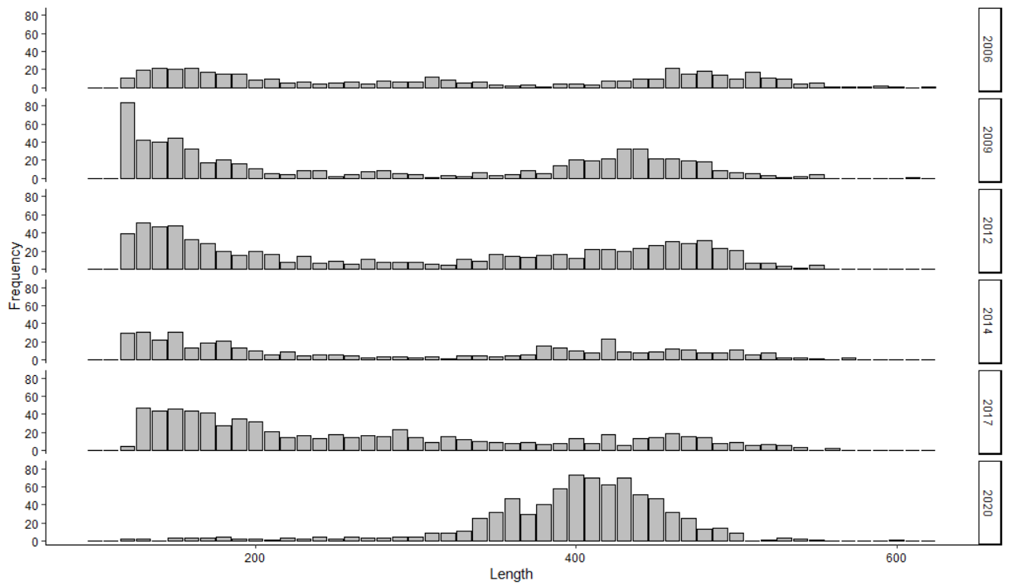
Notes:
If we look at the length frequency histograms from those surveys, TL on the x axis, frequency on the y axis, and year as the panels on the right hand side of the screen. Pre-fire we have two groups, smaller fish around 225 mm or less, and larger fish around 400 mm. In 2014, you can see the size of those frequency bars is less than the 2012 survey, then 2017 had a strong cohort of smedium fish (> 300 mm) and 2020 had strong cohort of larger fish (400 mm)

Slide 24
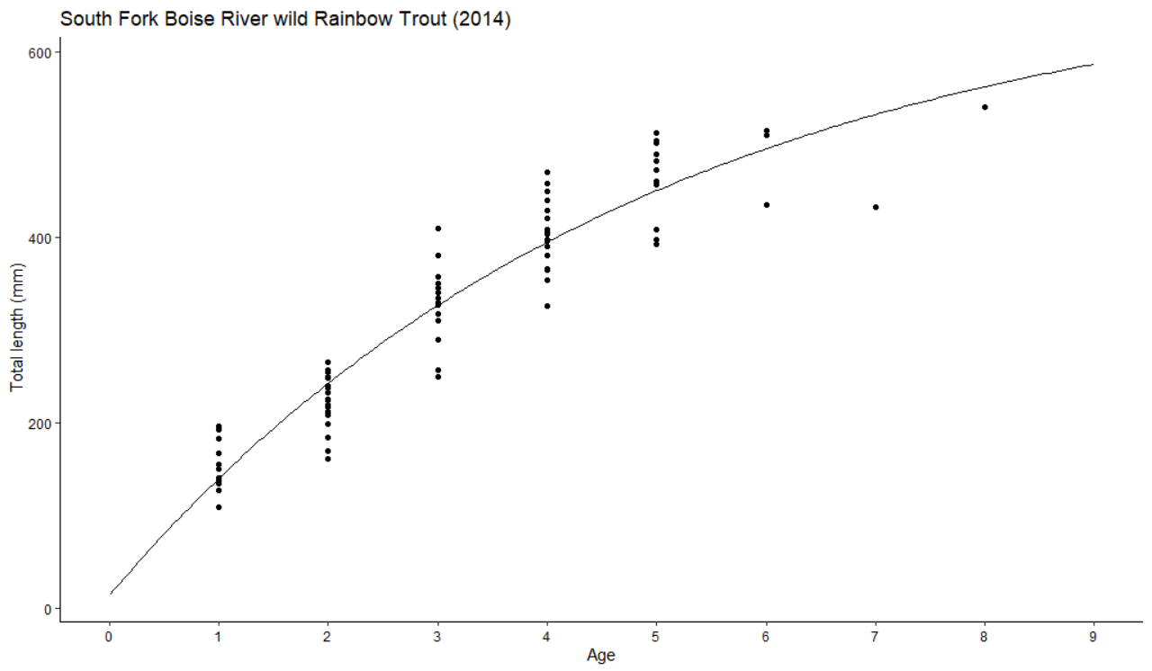
Notes:
If you’re asking yourself, how old a fish would be at all those lengths, in 2014 the region took length at age data from fin rays of SFBR trout and developed a von Bertanlanffy growth function. Age is on the x axis, total length is on the y axis. You can see, a age-2 fish is around 200 mm, an age-4 fish is around 400 mm. So it makes sense, in 2017 we had a decent cohort of fish around 250 – 300mm (which would be age-3, and now we have a strong cohort of fish around 400 mm, which could be age-5 or so…

Slide 25
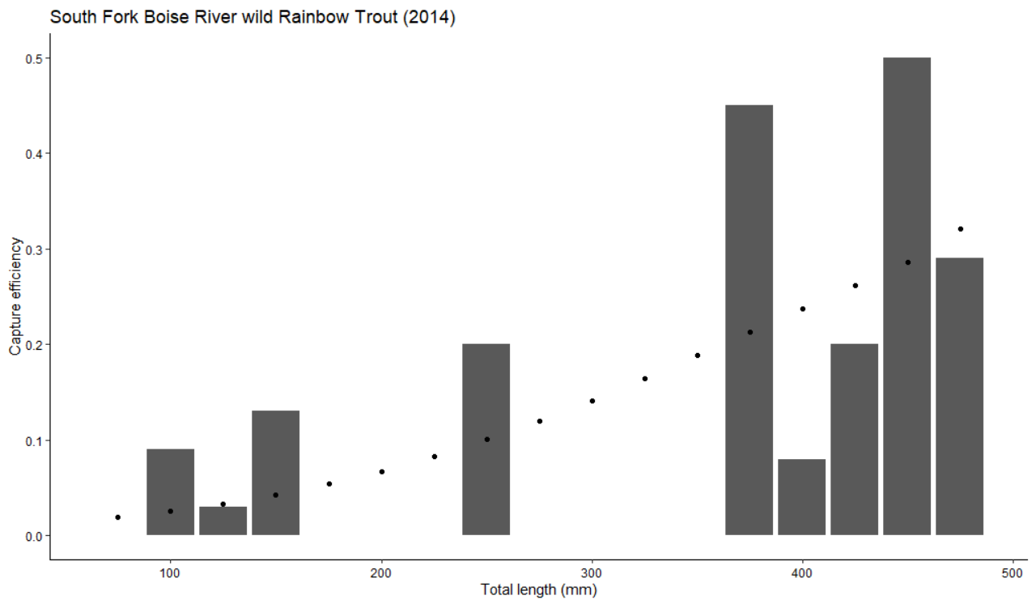
Notes:
One thing to note, however, is our capture efficiency. These plots are the modeled capture efficiency (shown by the points), and the actual capture efficiency (shown by the columns). Total length is on the x axis, proportional capture efficiency is on the y axis. In 2014, the modeled efficiency under predicted what we actually captured for small fish, and slightly overpredicted what we actually captured for larger fish. There is however, a large gap in those intermediate fish.

Slide 26
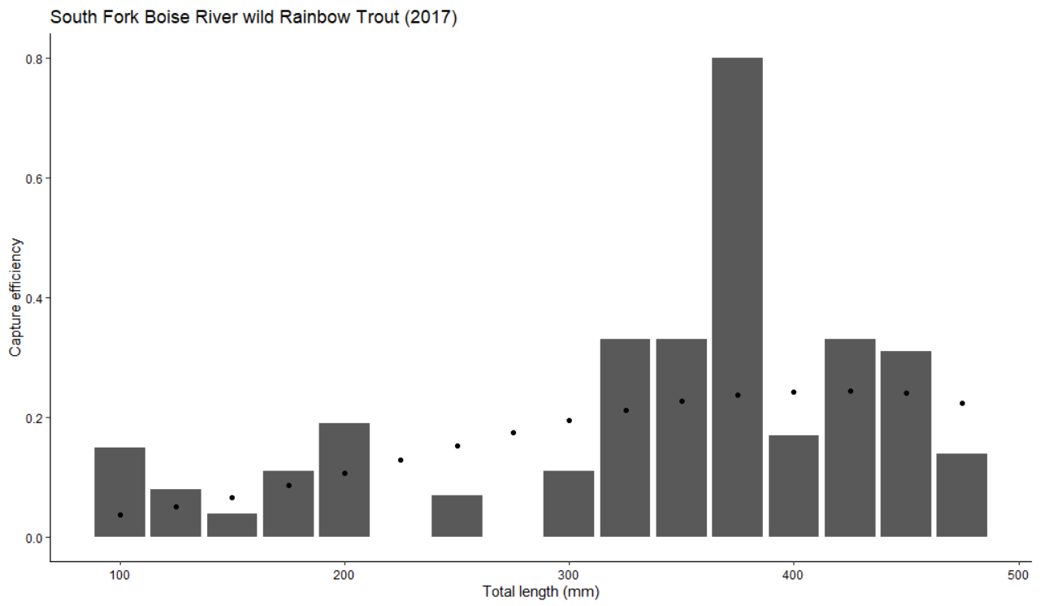
Notes:
In 2017, same axis, same points and columns, the modeled and actual capture efficiencies more closely aligned, with some slight discrepancies.

Slide 27
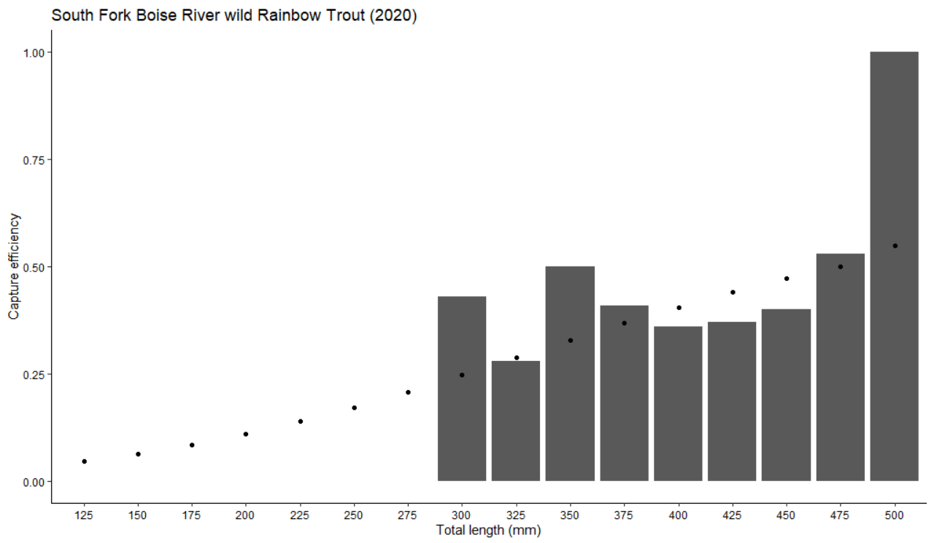
Notes:
However, in 2020, we hardly captured any small fish, but with fish greater than 300 mm, we did a pretty good job when you look at the actual versus modeled capture efficiencies.

Slide 28
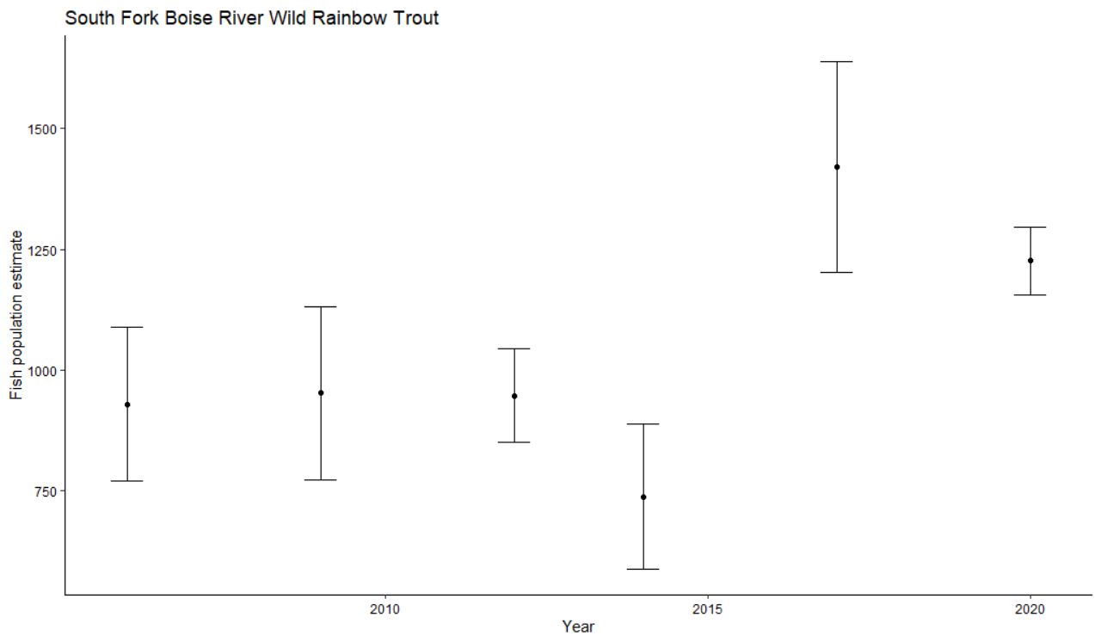
Notes:
If we adjust our population estimates x year with 225 mm minimum length cutoff. The patterns you would expect fall out; pre-fire (2006 to 2012) the population held steady. Directly post-fire and debris flow (2014), the population decreased. Then three years later in 2017, the population increased by almost 40%. And then in 2020, the point estimate is slightly lower, however the confidence intervals are much tighter around that estimate and they overlap with the 2017 estimate.

Slide 29
Discussion
Population estimate decreased following 2013 fires and 2014 debris flows
Population estimate increased in 2017
2020 population estimate slightly lower, likely due to minimal recaptures of small (> 225 mm) fish
Notes:
So to wrap up, based on our triennial surveys, the trout population estimates in the SFBR decreased following the 2013 fires and 2013 – 2014 debris flows. Yet, three years later in 2017, we saw a marked increase in the population estimate.. The 2020 estimate was slightly lower, but was hampered by low capture rates of small (225 mm) fish.

Slide 30
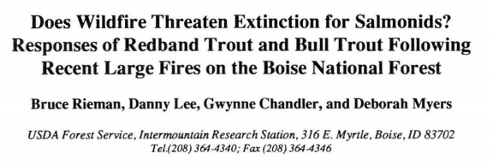
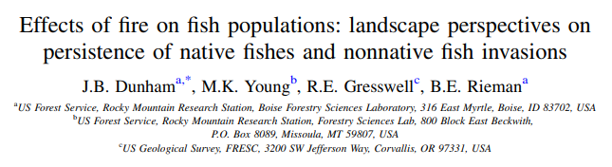
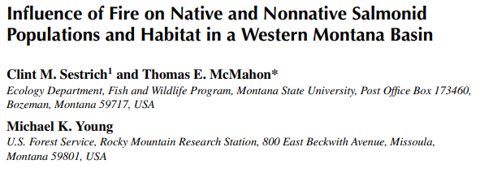
Discussion
Notes:
The population-level responses we observed post-fire were not unexpected. With the increased prevalence of wildfire, especially in the west. Rieman et al 1997 worked in a drainage near the SFBR and found fish were present within 1 year post-fire, and within 1-3 years the population approached pre-fire levels. They also noted juvenile densities increased and that recruitment may have benefitted from the fire. They also noted temporary declines in abundance, particularly in smaller (younger) fish.
Sestrich et al 2011 had similar findings; temporary population depression post-fire but rapid recovery.

Slide 31
Fry Surveys - Spring

Slide 32
Fry Surveys - Spring

Slide 33
Fry Surveys - Fall

Slide 34
Fry Surveys - Fall

Slide 35
Fry Surveys

Slide 36
Fry Surveys

Slide 37
Fry Surveys

Slide 38
Fry Surveys

Slide 39
Fry Surveys

Slide 40
Fry Surveys

Slide 41
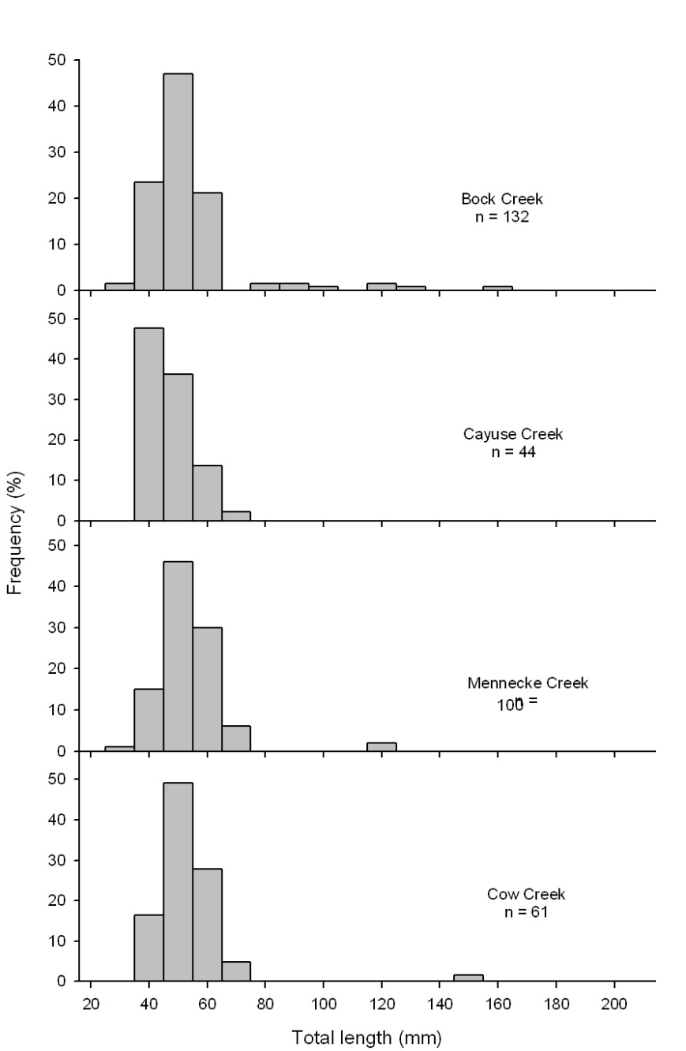
Tributary Surveys

Slide 42
Tributary Surveys – 2010 - 2011
 |  |  |  | < 100 mm |  |  | > 100 mm |  |  | Total
Stream | Site | Temp (°C) | Passes | Estimate | 95% CI |  | Estimate | 95% CI |  | Estimate | fish/100m²
Dixie Creek | DX1 | 11.1 | 1 | - | - |  | - | - |  | - | -
Granite Creek | GC1 | 18.4 | 1 | - | - |  | - | - |  | - | -
Pierce Creek | PC1 | 15.2 | 3 | 19 | 12-26 |  | 3 | 2-4 |  | 22 | 12.1
Pierce Creek | PC2 | 13.1 | 3 | 6 | 2-10 |  | 3 | 3-3 |  | 9 | 6
Pierce Creek | PC5 | - | 1 | - | - |  | - | - |  | - | -
Rock Creek | RK5 | 31.2 | 1 | - | - |  | - | - |  | - | -
Rock Creek | RK9 | 14.8 | 2 | 10 | 8-12 |  | 9 | 9-9 |  | 19 | 8.7
Rough Creek | RG1 | 18.1 | 1 | - | - |  | - | - |  | - | -
 |  |  |  | < 100 mm |  |  | > 100 mm |  |  | Total
Stream | Site | Temp (°C) | Passes | Estimate | 95% CI |  | Estimate | 95% CI |  | Estimate | fish/100m²
Bock Creek | 1 | 13.3 | 2 | 71 | 58-84 |  | - | - |  | 71 | 54.4
Bock Creek | 2 | 13.4 | 2 | 88 | 53-123 |  | 4 | 4-4 |  | 88 | 91.8
Cayuse Creek | 1 | 15.6 | 2 | 19 | 18-20 |  | - | - |  | 19 | 43.3
Cayuse Creek | 2 | 15.6 | 2 | 25 | 23-27 |  | - | - |  | 25 | 70.7
Cow Creek | 1 | 15.7 | 1 | - | - |  | - | - |  | -
Cow Creek | 2 | - | 1 | - | - |  | - | - |  | -
Cow Creek | 3 | - | 1 | - | - |  | - | - |  | -
Mennecke Creek | 1 | 16.2 | 2 | 80 | 74-86 |  | 1 | 1-1 |  | 81 | 128.6
Mennecke Creek | 2 | 13.7 | 2 | 22 | 18-26 |  | 1 | 1-1 |  | 23 | 44.9

Slide 43
Questions & Comments
Notes:
And with that, I would like to thank all of the folks who helped collect this dataset, hardcore or otherwise and I would be happy to take any questions.

